Slide 1
Educational Escape Room Activity
Where do we start?
How about right here?

Slide 2
Step 1: Consider the physical space
Availability of space: Time and size constraints
Availability of props:
  Physical: furniture, décor, puzzle and lock materials
  Technological: Video, iPad apps, online resources

Slide 3
Step 2: Define Objectives
The first step is deciding what information we want students to gain:
Introduction of a new concept
Review of vocabulary
Review of Grammar
Review of other content taught
A mix…

Slide 4
Time and Difficulty:
How much can be covered?
For the purposes of a 50-60 minute class period, limit to a few main concepts that will be linked to a max of 7-9 different puzzles/tasks.
Make one or two tasks fairly simple, for confidence building, but the key is a balance between easy, moderate, and challenging tasks.

Slide 5
Step 3: Developing a theme
An engaging thematic thread makes the game more enjoyable, and immerses players into the scenario more fully.
It should create a timed “escape mode” framework that connects the storyline, learning objectives, and mystery puzzles into a cohesive experience.

Slide 6
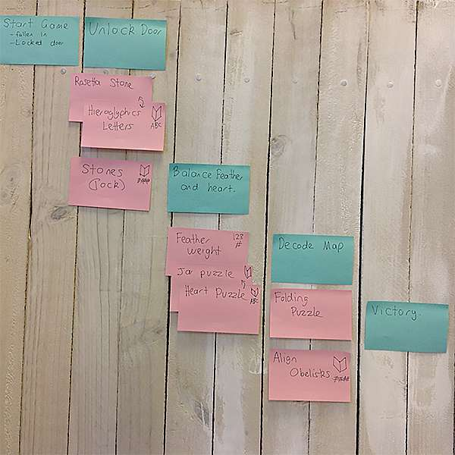
Step 4: Developing a storyline
Developing the theme into a comprehensive storyline that includes specific tasks can be achieved by creating a flowchart or roadmap that will clarify the progression of the activity.
https://platform.breakoutedu.com/game/holiday-express
(Holiday Express)

Slide 7

Step 5:
Developing the Puzzles
Puzzle Design: Puzzles and riddles make the experience interesting and fun! They should refer back to the learning objectives and goals of the session.
Physical/technological props: Setting the stage can be as simple/complicated as time and funding allow.
Instructions/Manuals: Good experiences have clear, set instructions and rules.
Clues/Hints: Everyone gets stuck once in a while. Thought should be given to how clues can be delivered to the players (i.e. via computer, phone, hint cards…)

Slide 8
Developing the Puzzles:
Looking for inspiration?
  Breakout edu Free access:
    https://platform.breakoutedu.com/signup
  Online….
  Go to a commercial escape room

Slide 9
Step 6: Before launch
Before delivery, it’s imperative to test the experience with people who have not been part of the design process. (Issues of timing, flow, clarity can be addressed.)

Slide 10
Step 7: Delivery
Brief: Providing students with an explanation of the game, setting the expectations, time limits, and rules.
Play: players can now engage in active learning. Recording the actions of the players can prove entertaining for both the players and game-facilitator, as well as useful for feedback and design improvement.
Debrief: Facilitator provides feedback as well as a run-though of puzzle solutions. The process can provide insight into team-dynamics, communication, and different ways students approach problems. participants should be asked how/if the activity can help them moving forward with their studies.

Slide 11
Step 8: After the activity –
Assessment
Reflection: A focus group session/feedback sheet may be used to gather information:
  Did students learn anything? If so what? Did they have fun? What was the most interesting thing? What worked? What didn’t? How would they make it better?
Evaluation: Have the learning objectives been achieved?
Adjustment: Use iterative design and development to help refine the experience.

Slide 12
Step 9: Expansion opportunities
Current grant: Proof of concept (How many “experiences”?)
Documentation of process
How do we create scalability, “transferability”? (between languages, disciplines…)

Slide 13
What next:
Irit and Osnat: Define learning objectives
All: explore (slide 8)
All: visit physical space
Next meeting: Brainstorm – Ideas for themes and storylines, begin to formulate an action plan.

