Slide 1
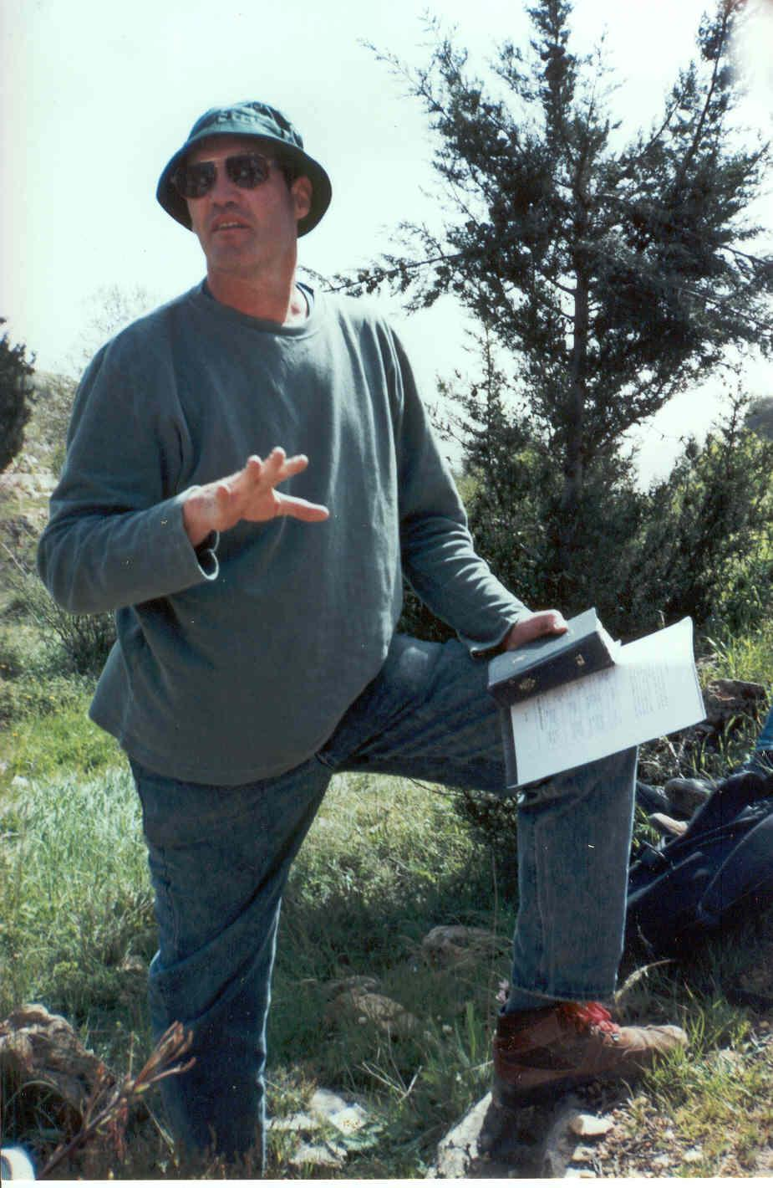
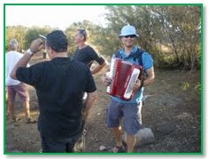
הטיול כאידאולוגיה
עמדה אנטי בורגנית, אנטי גלותית
ללמוד "דרך הרגליים"
התעוררות לאומית והבלטה דורית

Slide 2
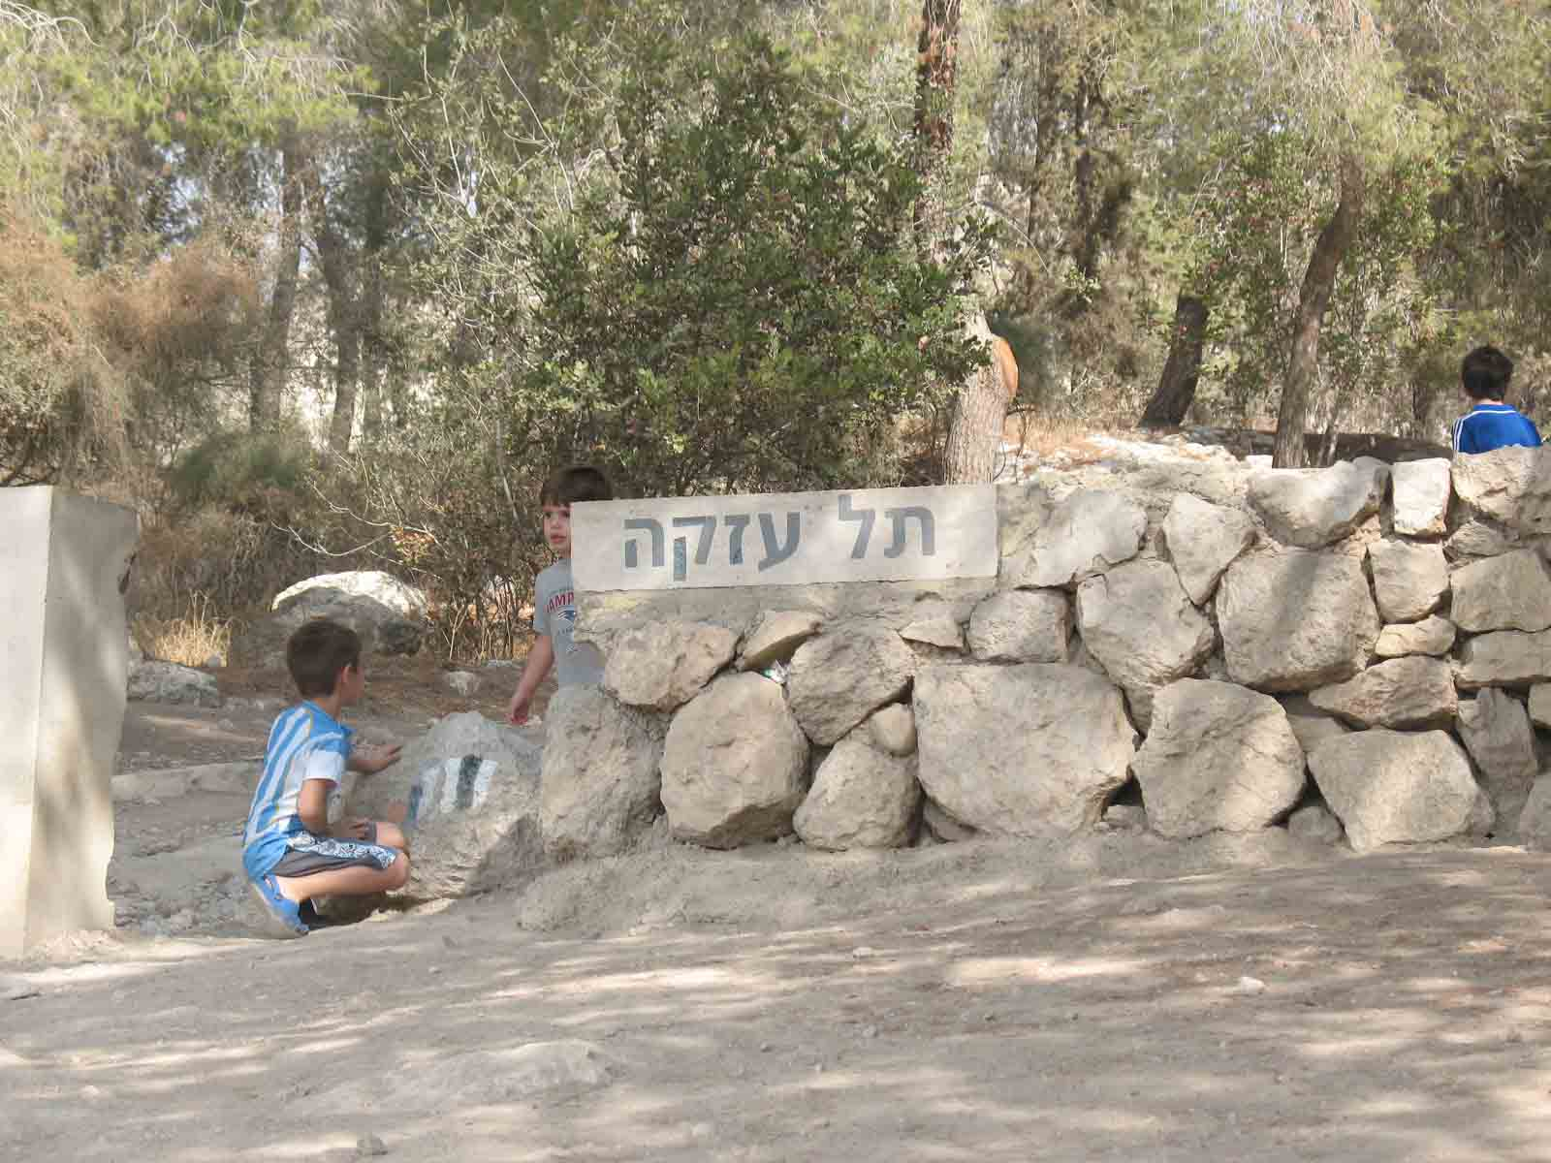
קרב דוד וגלית – תל עזקה

Slide 3
1 Samuel Chapter 17 שְׁמוּאֵל א
א וַיַּאַסְפוּ פְלִשְׁתִּים אֶת-מַחֲנֵיהֶם, לַמִּלְחָמָה, וַיֵּאָסְפוּ, שֹׂכֹה אֲשֶׁר לִיהוּדָה; וַיַּחֲנוּ בֵּין-שׂוֹכֹה וּבֵין-עֲזֵקָה, בְּאֶפֶס דַּמִּים. | 1 Now the Philistines gathered together their armies to battle, and they were gathered together at Socoh, which belongeth to Judah, and pitched between Socoh and Azekah, in Ephes-dammim.
ב וְשָׁאוּל וְאִישׁ-יִשְׂרָאֵל נֶאֶסְפוּ, וַיַּחֲנוּ בְּעֵמֶק הָאֵלָה; וַיַּעַרְכוּ מִלְחָמָה, לִקְרַאת פְּלִשְׁתִּים. | 2 And Saul and the men of Israel were gathered together, and pitched in the vale of Elah, and set the battle in array against the Philistines.
ג וּפְלִשְׁתִּים עֹמְדִים אֶל-הָהָר, מִזֶּה, וְיִשְׂרָאֵל עֹמְדִים אֶל-הָהָר, מִזֶּה; וְהַגַּיְא, בֵּינֵיהֶם. | 3 And the Philistines stood on the mountain on the one side, and Israel stood on the mountain on the other side; and there was a valley between them.

Slide 4
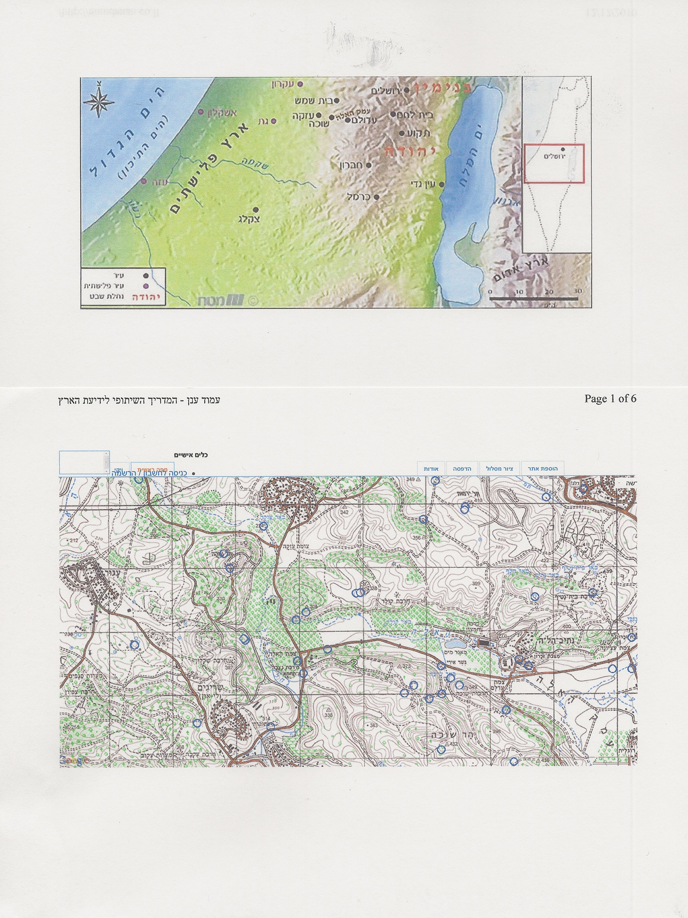
Notes:
להראות את האזור ב google earth

Slide 6
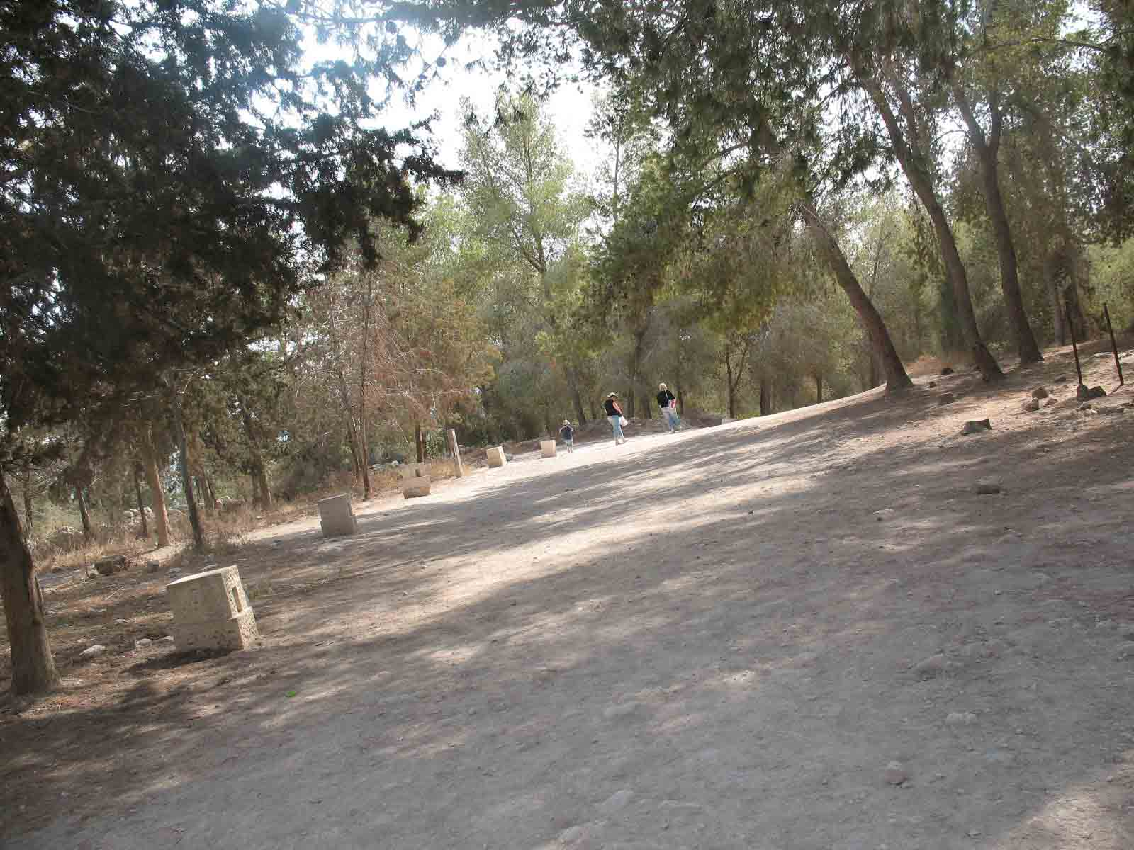

Slide 7
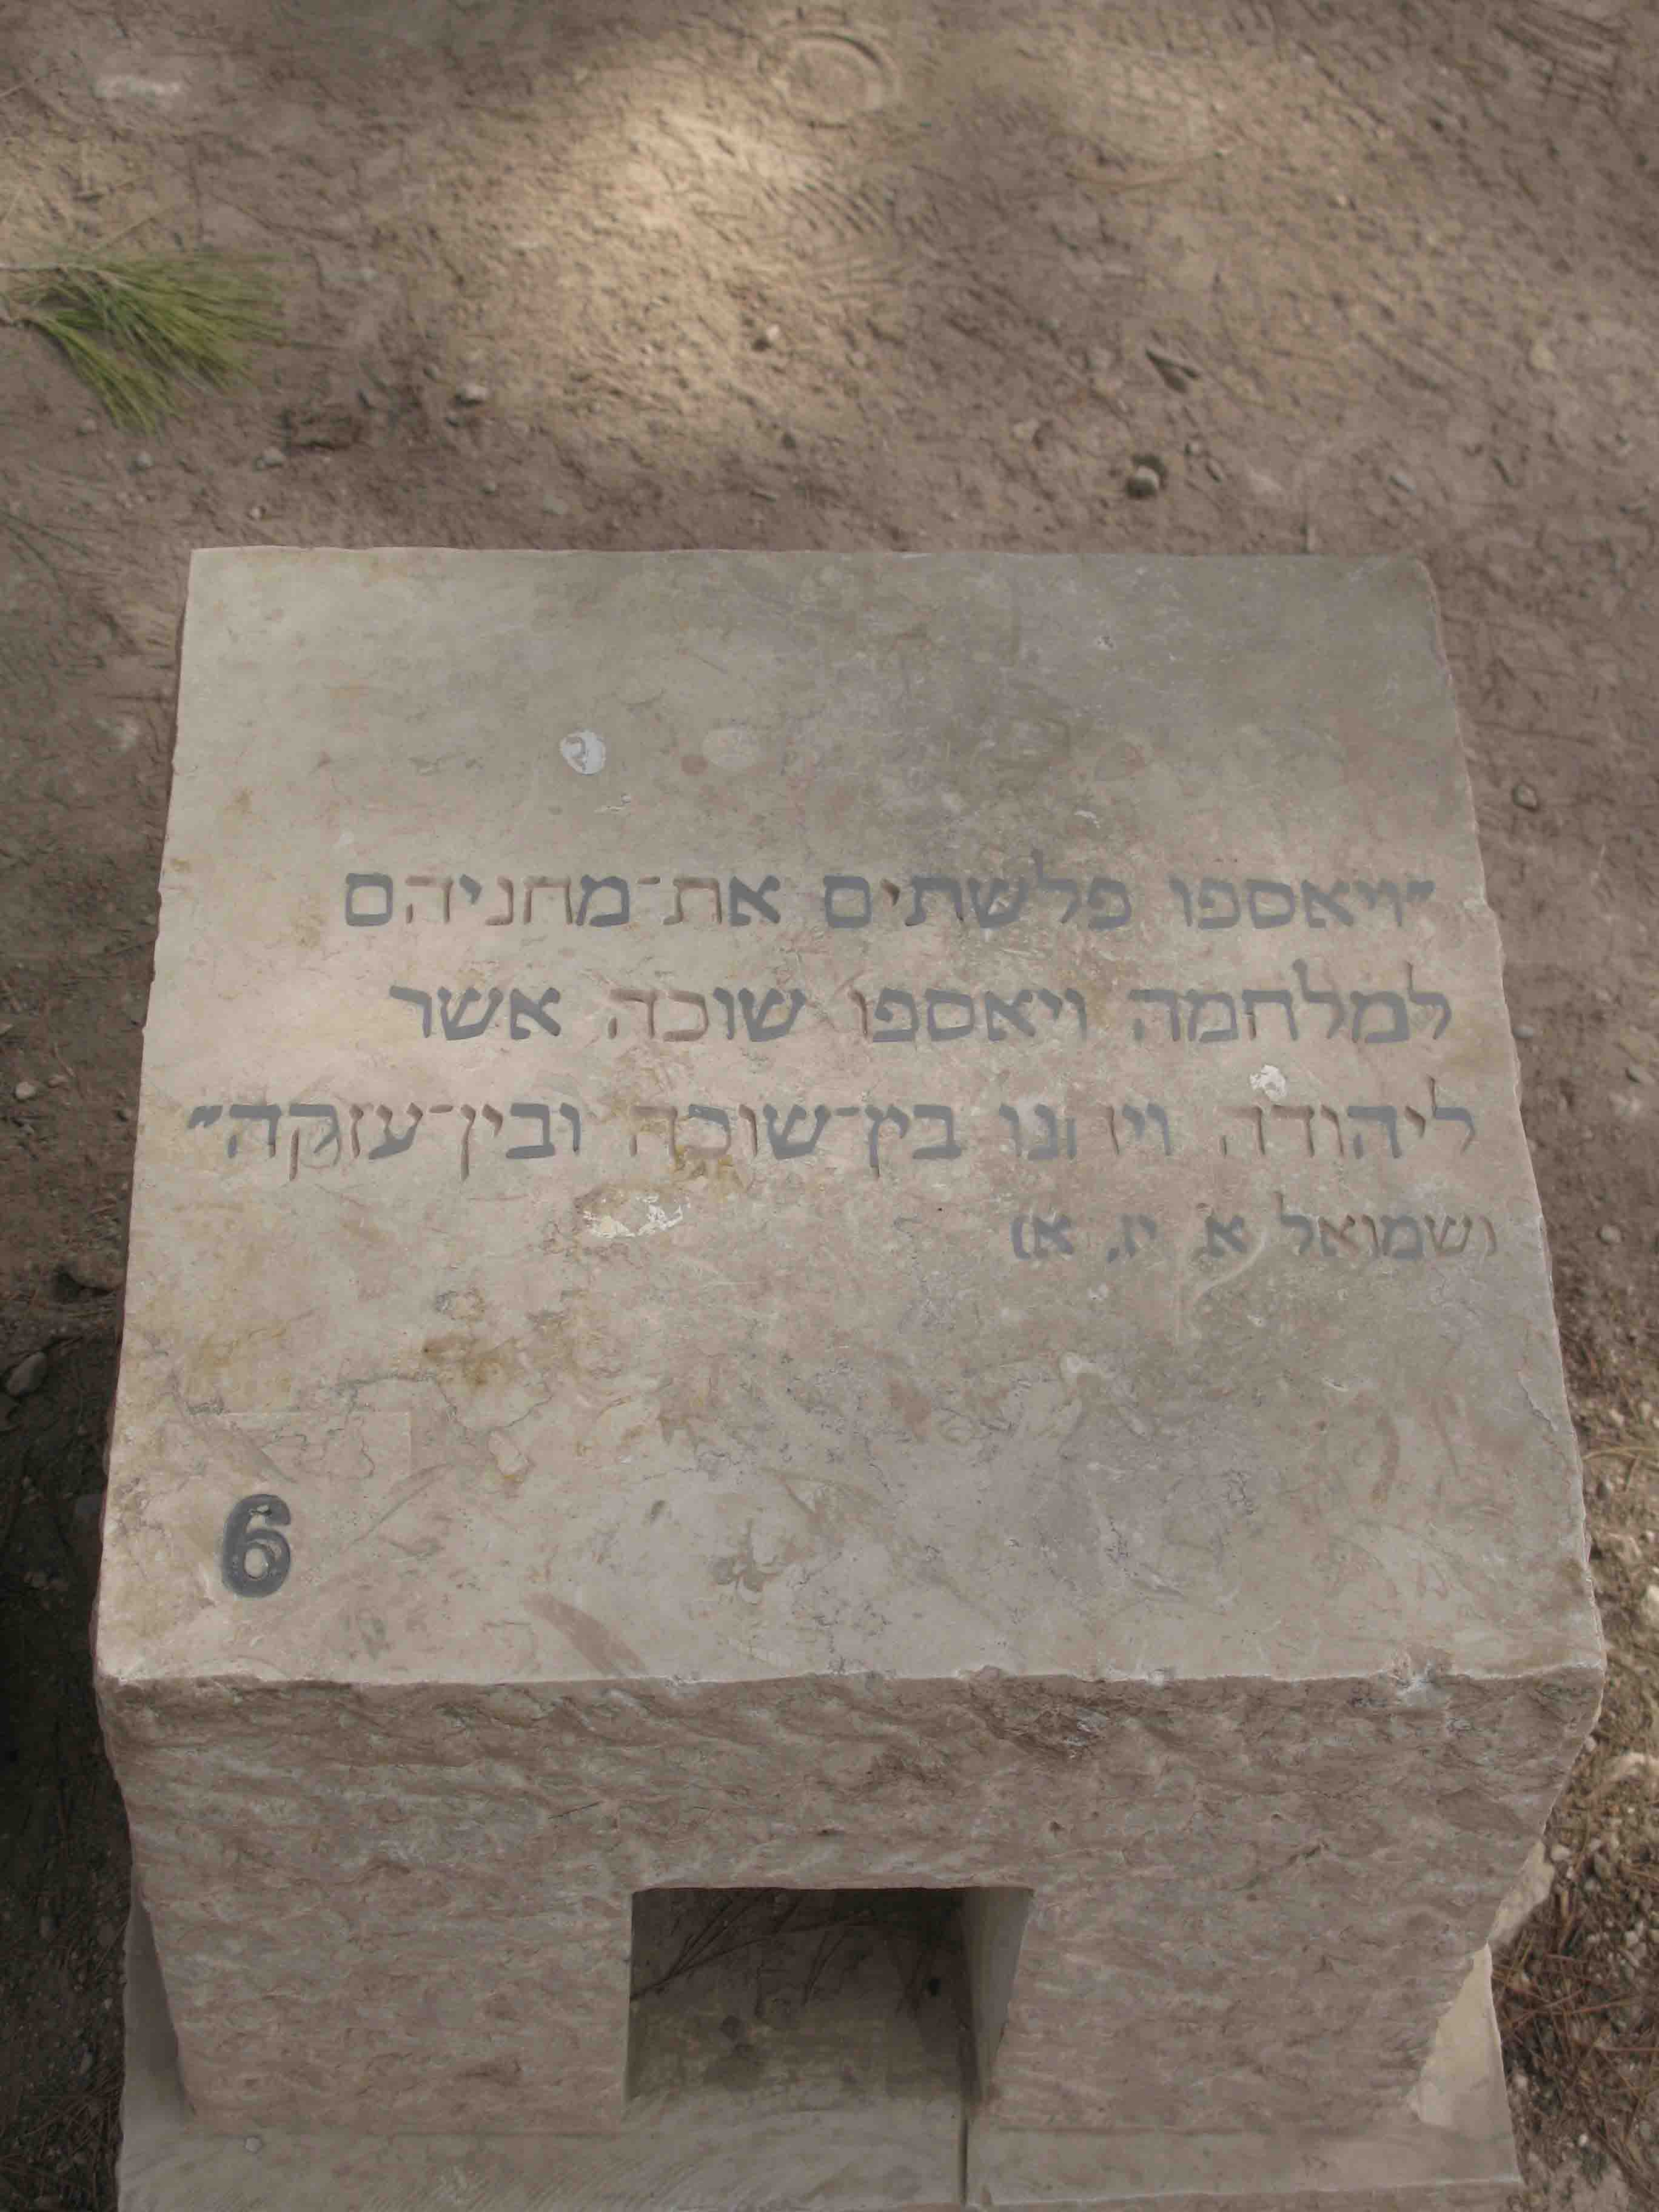

Slide 8
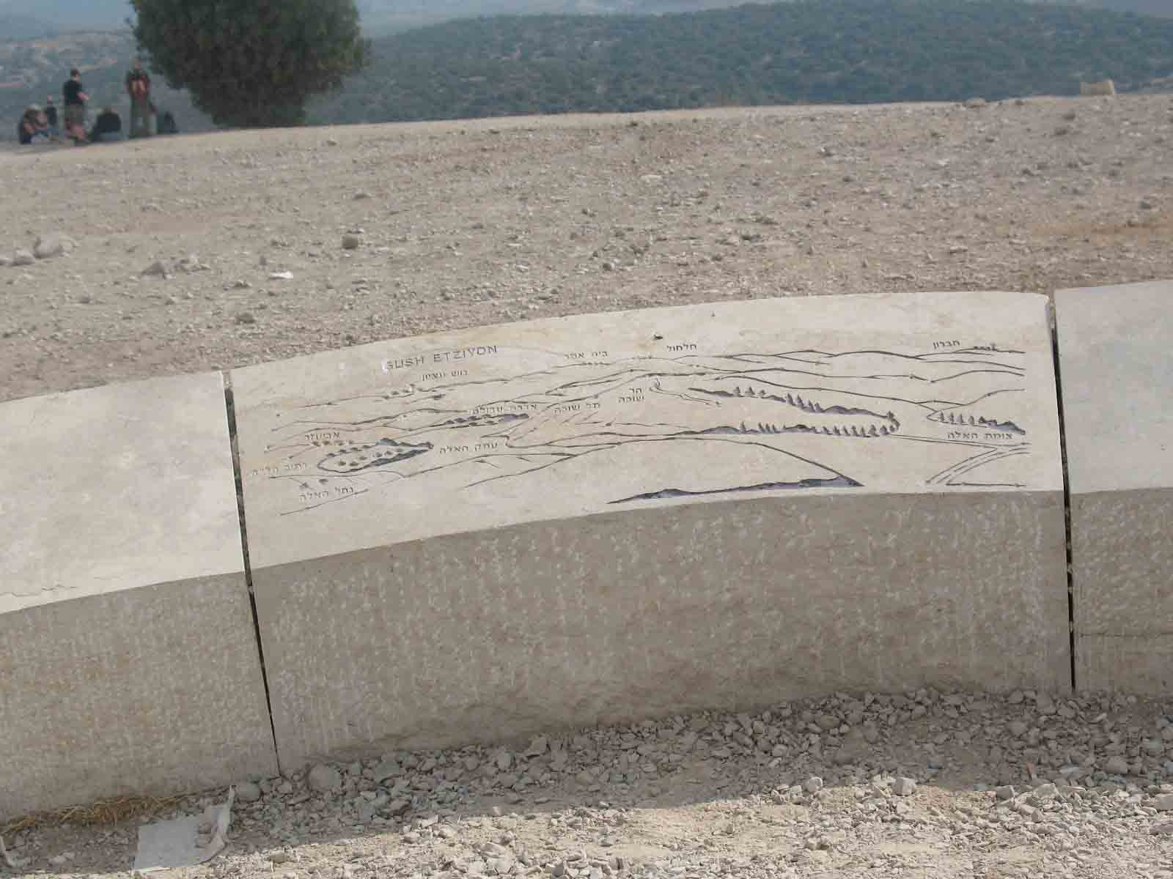
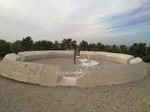

Slide 9
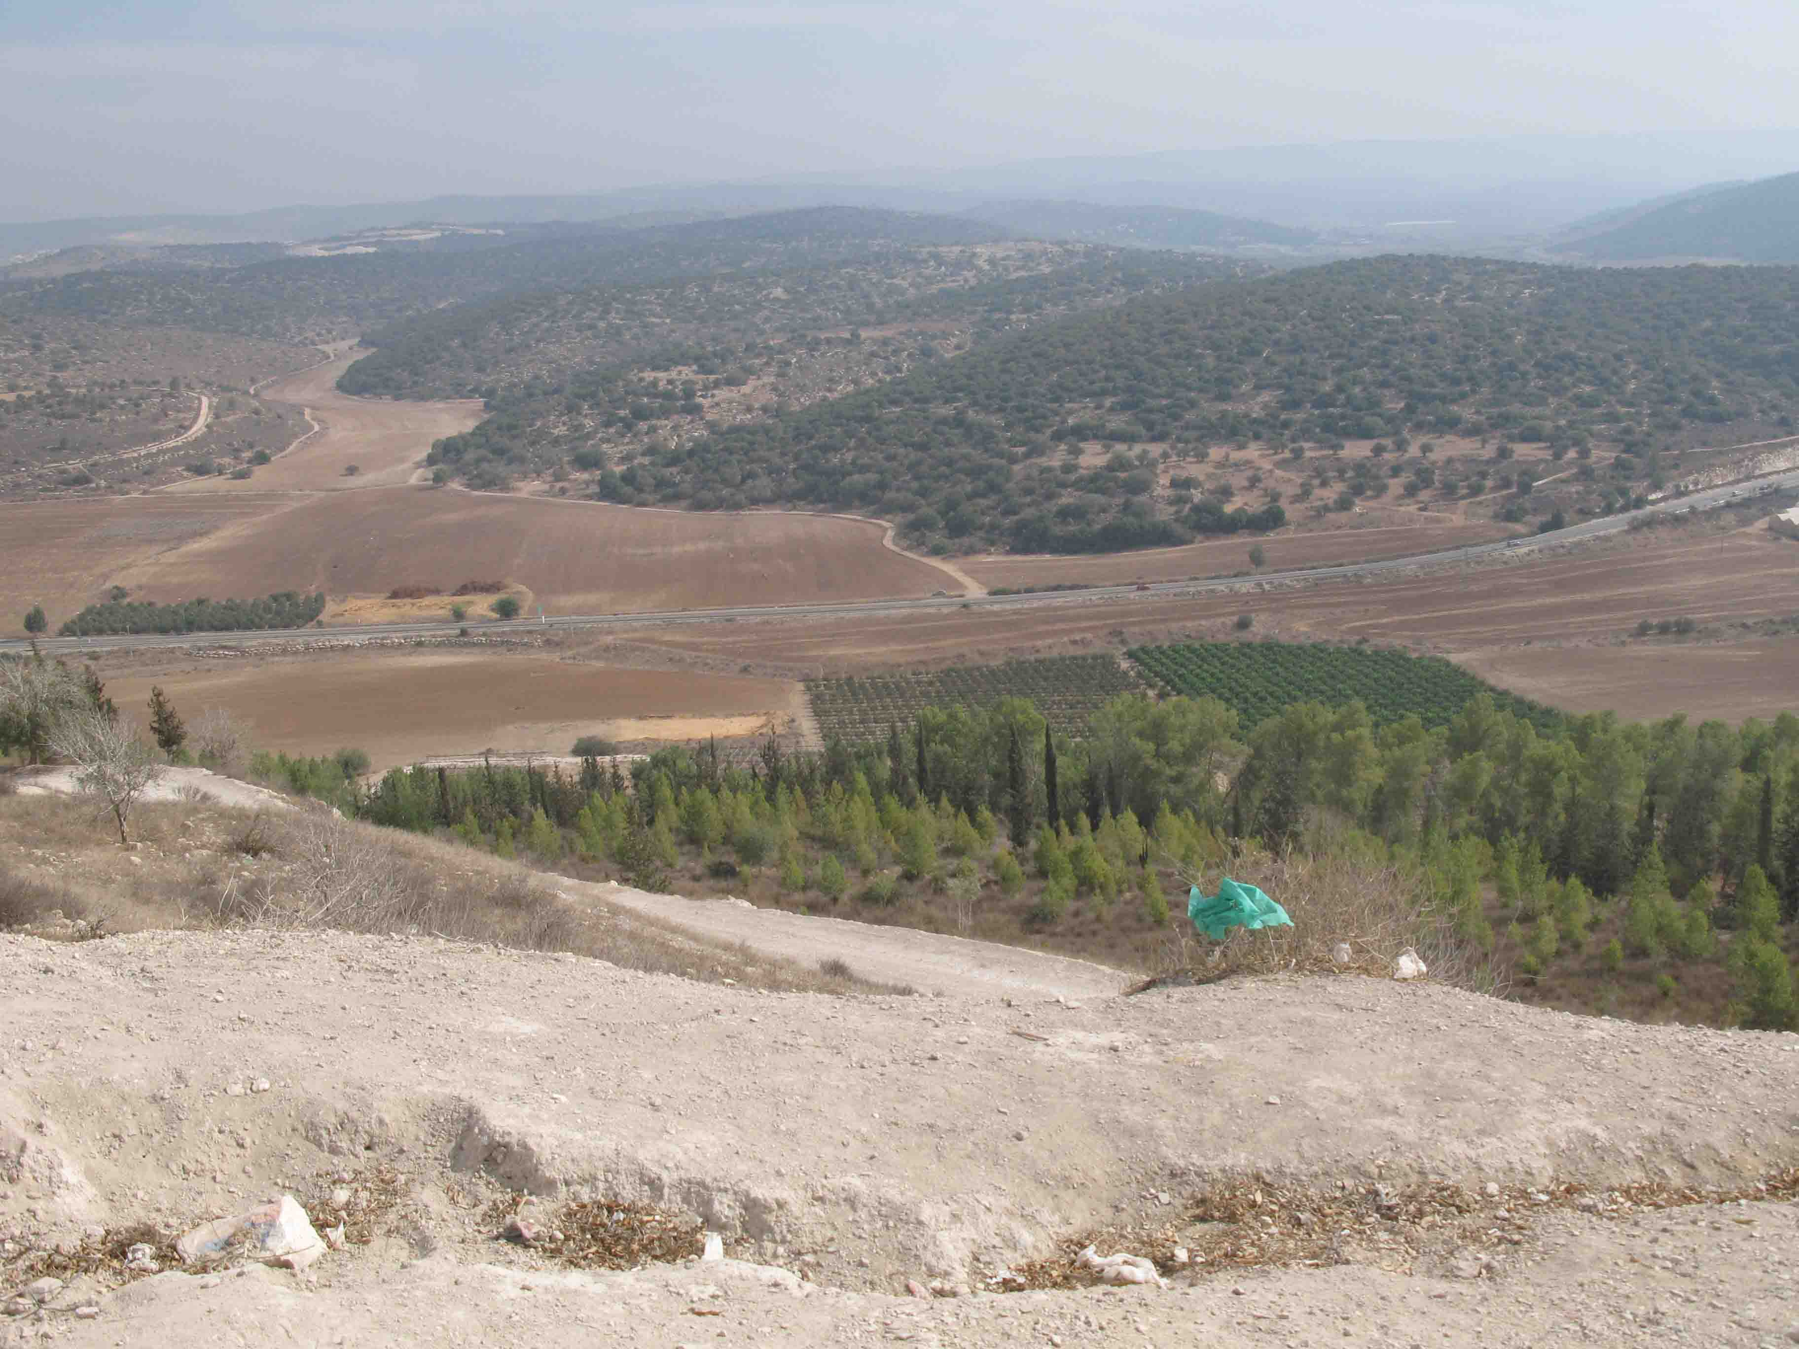

Slide 10
ד וַיֵּצֵא אִישׁ-הַבֵּנַיִם מִמַּחֲנוֹת פְּלִשְׁתִּים, גָּלְיָת שְׁמוֹ מִגַּת: גָּבְהוֹ, שֵׁשׁ אַמּוֹת וָזָרֶת. | 4 And there went out a champion from the camp of the Philistines, named Goliath, of Gath, whose height was six cubits and a span.
ה וְכוֹבַע נְחֹשֶׁת עַל-רֹאשׁוֹ, וְשִׁרְיוֹן קַשְׂקַשִּׂים הוּא לָבוּשׁ; וּמִשְׁקַל, הַשִּׁרְיוֹן--חֲמֵשֶׁת-אֲלָפִים שְׁקָלִים, נְחֹשֶׁת. | 5 And he had a helmet of brass upon his head, and he was clad with a coat of mail; and the weight of the coat was five thousand shekels of brass.
ו וּמִצְחַת נְחֹשֶׁת, עַל-רַגְלָיו; וְכִידוֹן נְחֹשֶׁת, בֵּין כְּתֵפָיו. | 6 And he had greaves of brass upon his legs, and a javelin of brass between his shoulders.
ז וחץ (וְעֵץ) חֲנִיתוֹ, כִּמְנוֹר אֹרְגִים, וְלַהֶבֶת חֲנִיתוֹ, שֵׁשׁ-מֵאוֹת שְׁקָלִים בַּרְזֶל; וְנֹשֵׂא הַצִּנָּה, הֹלֵךְ לְפָנָיו. | 7 And the shaft of his spear was like a weaver's beam; and his spear's head weighed six hundred shekels of iron; and his shield-bearer went before him.

Slide 11
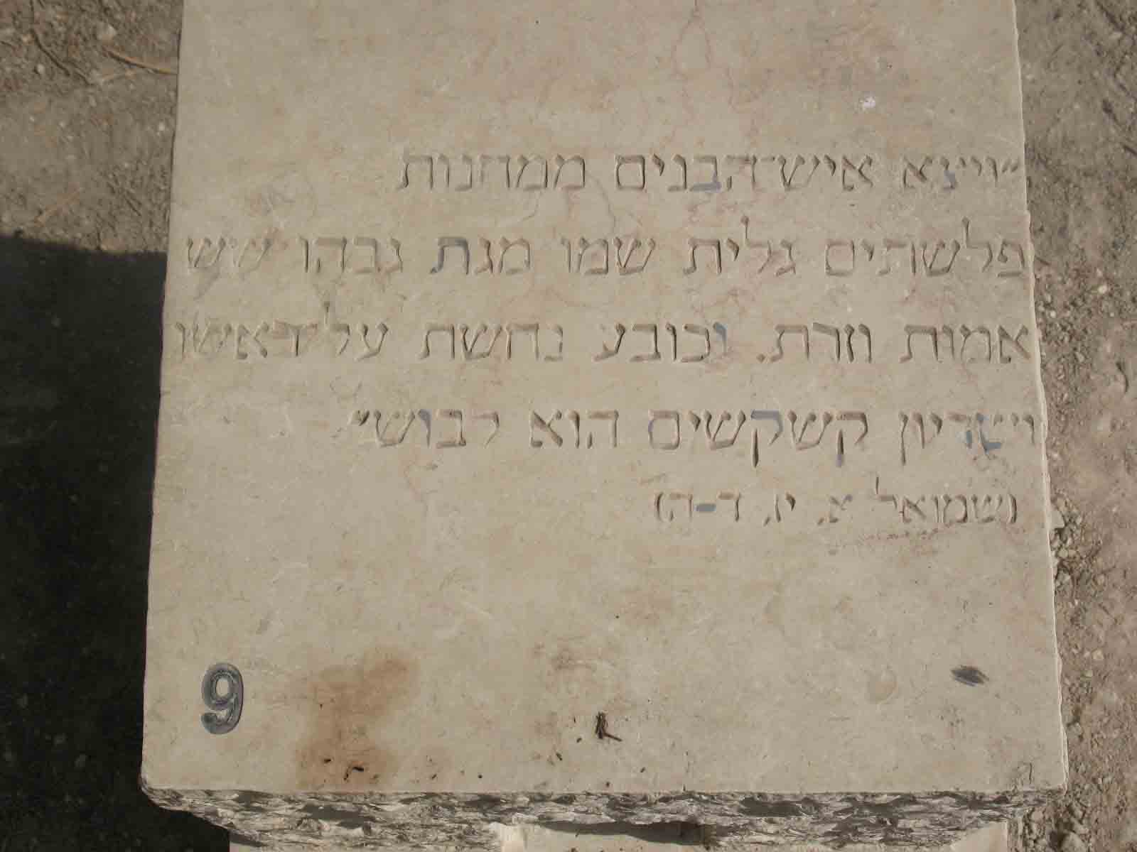

Slide 12
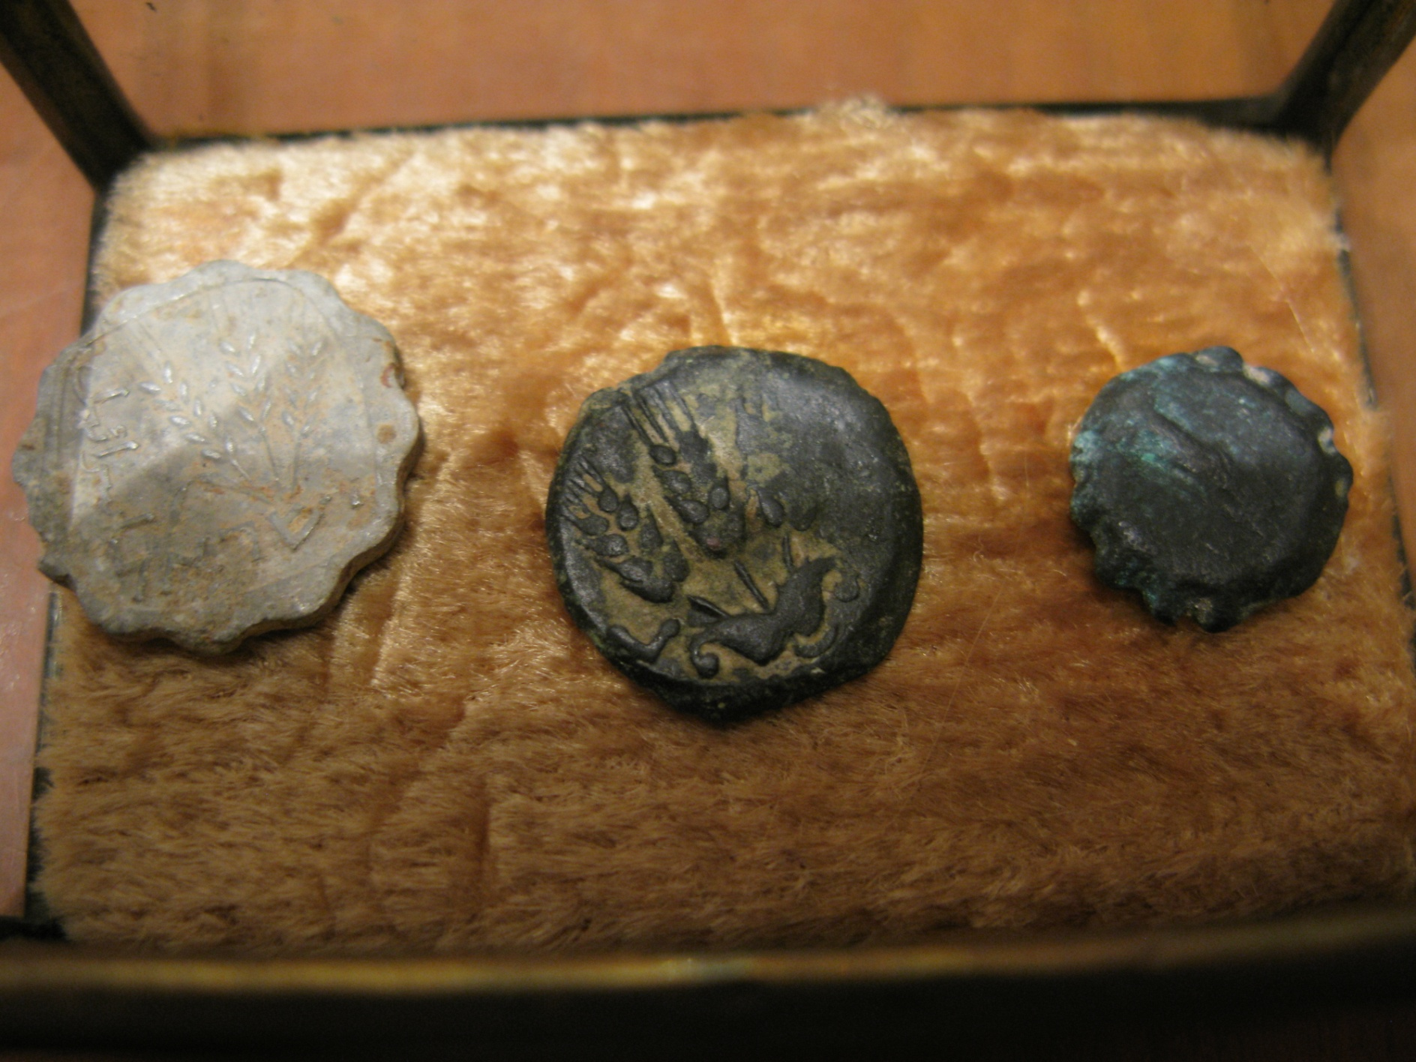
http://he.wikipedia.org/wiki/%D7%A9%D7%A7%D7%9C

Slide 13
ח וַיַּעֲמֹד, וַיִּקְרָא אֶל-מַעַרְכֹת יִשְׂרָאֵל, וַיֹּאמֶר לָהֶם, לָמָּה תֵצְאוּ לַעֲרֹךְ מִלְחָמָה: הֲלוֹא אָנֹכִי הַפְּלִשְׁתִּי, וְאַתֶּם עֲבָדִים לְשָׁאוּל--בְּרוּ-לָכֶם אִישׁ, וְיֵרֵד אֵלָי. | 8 And he stood and cried unto the armies of Israel, and said unto them: 'Why do ye come out to set your battle in array? am not I a Philistine, and ye servants to Saul? choose you a man for you, and let him come down to me.
ט אִם-יוּכַל לְהִלָּחֵם אִתִּי, וְהִכָּנִי--וְהָיִינוּ לָכֶם, לַעֲבָדִים; וְאִם-אֲנִי אוּכַל-לוֹ, וְהִכִּיתִיו--וִהְיִיתֶם לָנוּ לַעֲבָדִים, וַעֲבַדְתֶּם אֹתָנוּ. | 9 If he be able to fight with me, and kill me, then will we be your servants; but if I prevail against him, and kill him, then shall ye be our servants, and serve us.'
י וַיֹּאמֶר, הַפְּלִשְׁתִּי, אֲנִי חֵרַפְתִּי אֶת-מַעַרְכוֹת יִשְׂרָאֵל, הַיּוֹם הַזֶּה; תְּנוּ-לִי אִישׁ, וְנִלָּחֲמָה יָחַד. | 10 And the Philistine said: 'I do taunt the armies of Israel this day; give me a man, that we may fight together.'
יא וַיִּשְׁמַע שָׁאוּל וְכָל-יִשְׂרָאֵל, אֶת-דִּבְרֵי הַפְּלִשְׁתִּי הָאֵלֶּה; וַיֵּחַתּוּ וַיִּרְאוּ, מְאֹד. {פ} | 11 And when Saul and all Israel heard those words of the Philistine, they were dismayed, and greatly afraid. {P}
Notes:
גולית מחרף= מלגלג, אומר לצבא ישראל מי אתם?

Slide 14
יב וְדָוִד בֶּן-אִישׁ אֶפְרָתִי הַזֶּה, מִבֵּית לֶחֶם יְהוּדָה, וּשְׁמוֹ יִשַׁי, וְלוֹ שְׁמֹנָה בָנִים; וְהָאִישׁ בִּימֵי שָׁאוּל, זָקֵן בָּא בַאֲנָשִׁים. | 12 Now David was the son of that Ephrathite of Beth-lehem in Judah, whose name was Jesse; and he had eight sons; and the man was an old man in the days of Saul, stricken in years among men.
יג וַיֵּלְכוּ שְׁלֹשֶׁת בְּנֵי-יִשַׁי, הַגְּדֹלִים--הָלְכוּ אַחֲרֵי-שָׁאוּל, לַמִּלְחָמָה; וְשֵׁם שְׁלֹשֶׁת בָּנָיו, אֲשֶׁר הָלְכוּ בַּמִּלְחָמָה--אֱלִיאָב הַבְּכוֹר וּמִשְׁנֵהוּ אֲבִינָדָב, וְהַשְּׁלִשִׁי שַׁמָּה. | 13 And the three eldest sons of Jesse had gone after Saul to the battle; and the names of his three sons that went to the battle were Eliab the first-born, and next unto him Abinadab, and the third Shammah.
טו וְדָוִד הֹלֵךְ וָשָׁב, מֵעַל שָׁאוּל, לִרְעוֹת אֶת-צֹאן אָבִיו, בֵּית-לָחֶם. | 15 Now David went to and fro from Saul to feed his father's sheep at Beth-lehem.--
יז וַיֹּאמֶר יִשַׁי לְדָוִד בְּנוֹ, קַח-נָא לְאַחֶיךָ אֵיפַת הַקָּלִיא הַזֶּה, וַעֲשָׂרָה לֶחֶם, הַזֶּה; וְהָרֵץ הַמַּחֲנֶה, לְאַחֶיךָ. | 17 And Jesse said unto David his son: 'Take now for thy brethren an ephah of this parched corn, and these ten loaves, and carry them quickly to the camp to thy brethren.

Slide 15
כב וַיִּטֹּשׁ דָּוִד אֶת-הַכֵּלִים מֵעָלָיו, עַל-יַד שׁוֹמֵר הַכֵּלִים, וַיָּרָץ, הַמַּעֲרָכָה; וַיָּבֹא, וַיִּשְׁאַל לְאֶחָיו לְשָׁלוֹם. | 22 And David left his baggage in the hand of the keeper of the baggage, and ran to the army, and came and greeted his brethren.
כג וְהוּא מְדַבֵּר עִמָּם, וְהִנֵּה אִישׁ הַבֵּנַיִם עוֹלֶה גָּלְיָת הַפְּלִשְׁתִּי שְׁמוֹ מִגַּת ממערות (מִמַּעַרְכוֹת) פְּלִשְׁתִּים, וַיְדַבֵּר, כַּדְּבָרִים הָאֵלֶּה; וַיִּשְׁמַע, דָּוִד. | 23 And as he talked with them, behold, there came up the champion, the Philistine of Gath, Goliath by name, out of the ranks of the Philistines, and spoke according to the same words; and David heard them.
כד וְכֹל אִישׁ יִשְׂרָאֵל, בִּרְאוֹתָם אֶת-הָאִישׁ; וַיָּנֻסוּ, מִפָּנָיו, וַיִּירְאוּ, מְאֹד. | 24 And all the men of Israel, when they saw the man, fled from him, and were sore afraid.
כה וַיֹּאמֶר אִישׁ יִשְׂרָאֵל, הַרְּאִיתֶם הָאִישׁ הָעֹלֶה הַזֶּה--כִּי לְחָרֵף אֶת-יִשְׂרָאֵל, עֹלֶה; וְהָיָה הָאִישׁ אֲשֶׁר-יַכֶּנּוּ יַעְשְׁרֶנּוּ הַמֶּלֶךְ עֹשֶׁר גָּדוֹל, וְאֶת-בִּתּוֹ יִתֶּן-לוֹ, וְאֵת בֵּית אָבִיו, יַעֲשֶׂה חָפְשִׁי בְּיִשְׂרָאֵל. {פ} | 25 And the men of Israel said: 'Have ye seen this man that is come up? surely to taunt Israel is he come up; and it shall be, that the man who killeth him, the king will enrich him with great riches, and will give him his daughter, and make his father's house free in Israel.' {P}
כו וַיֹּאמֶר דָּוִד, אֶל-הָאֲנָשִׁים הָעֹמְדִים עִמּוֹ לֵאמֹר, מַה-יֵּעָשֶׂה לָאִישׁ אֲשֶׁר יַכֶּה אֶת-הַפְּלִשְׁתִּי הַלָּז, וְהֵסִיר חֶרְפָּה מֵעַל יִשְׂרָאֵל: כִּי מִי, הַפְּלִשְׁתִּי הֶעָרֵל הַזֶּה, כִּי חֵרֵף, מַעַרְכוֹת אֱלֹהִים חַיִּים. | 26 And David spoke to the men that stood by him, saying: 'What shall be done to the man that killeth this Philistine, and taketh away the taunt from Israel? for who is this uncircumcised Philistine, that he should have taunted the armies of the living God?'

Slide 16
לא וַיִּשָּׁמְעוּ, הַדְּבָרִים, אֲשֶׁר, דִּבֶּר דָּוִד; וַיַּגִּדוּ לִפְנֵי-שָׁאוּל, וַיִּקָּחֵהוּ. | 31 And when the words were heard which David spoke, they rehearsed them before Saul; and he was taken to him.
לב וַיֹּאמֶר דָּוִד אֶל-שָׁאוּל, אַל-יִפֹּל לֵב-אָדָם עָלָיו; עַבְדְּךָ יֵלֵךְ, וְנִלְחַם עִם-הַפְּלִשְׁתִּי הַזֶּה. | 32 And David said to Saul: 'Let no man's heart fail within him; thy servant will go and fight with this Philistine.'
לג וַיֹּאמֶר שָׁאוּל אֶל-דָּוִד, לֹא תוּכַל לָלֶכֶת אֶל-הַפְּלִשְׁתִּי הַזֶּה, לְהִלָּחֵם, עִמּוֹ: כִּי-נַעַר אַתָּה, וְהוּא אִישׁ מִלְחָמָה מִנְּעֻרָיו. {ס} | 33 And Saul said to David: 'Thou art not able to go against this Philistine to fight with him; for thou art but a youth, and he a man of war from his youth.' {S}

Slide 17
לד וַיֹּאמֶר דָּוִד אֶל-שָׁאוּל, רֹעֶה הָיָה עַבְדְּךָ לְאָבִיו בַּצֹּאן; וּבָא הָאֲרִי וְאֶת-הַדּוֹב, וְנָשָׂא שֶׂה מֵהָעֵדֶר. | 34 And David said unto Saul: 'Thy servant kept his father's sheep; and when there came a lion, or a bear, and took a lamb out of the flock,
לה וְיָצָאתִי אַחֲרָיו וְהִכִּתִיו, וְהִצַּלְתִּי מִפִּיו; וַיָּקָם עָלַי--וְהֶחֱזַקְתִּי בִּזְקָנוֹ, וְהִכִּתִיו וַהֲמִיתִּיו. | 35 I went out after him, and smote him, and delivered it out of his mouth; and when he arose against me, I caught him by his beard, and smote him, and slew him.
לו גַּם אֶת-הָאֲרִי גַּם-הַדֹּב, הִכָּה עַבְדֶּךָ; וְהָיָה הַפְּלִשְׁתִּי הֶעָרֵל הַזֶּה, כְּאַחַד מֵהֶם, כִּי חֵרֵף, מַעַרְכֹת אֱלֹהִים חַיִּים. {ס} | 36 Thy servant smote both the lion and the bear; and this uncircumcised Philistine shall be as one of them, seeing he hath taunted the armies of the living God.'{S}
לז וַיֹּאמֶר, דָּוִד, יְהוָה אֲשֶׁר הִצִּלַנִי מִיַּד הָאֲרִי וּמִיַּד הַדֹּב, הוּא יַצִּילֵנִי מִיַּד הַפְּלִשְׁתִּי הַזֶּה; {ס} וַיֹּאמֶר שָׁאוּל אֶל-דָּוִד לֵךְ, וַיהוָה יִהְיֶה עִמָּךְ. | 37 And David said: 'The LORD that delivered me out of the paw of the lion, and out of the paw of the bear, He will deliver me out of the hand of this Philistine.'{S} And Saul said unto David: 'Go, and the LORD shall be with thee.'

Slide 18
לח וַיַּלְבֵּשׁ שָׁאוּל אֶת-דָּוִד מַדָּיו, וְנָתַן קוֹבַע נְחֹשֶׁת עַל-רֹאשׁוֹ; וַיַּלְבֵּשׁ אֹתוֹ, שִׁרְיוֹן. | 38 And Saul clad David with his apparel, and he put a helmet of brass upon his head, and he clad him with a coat of mail.
לט וַיַּחְגֹּר דָּוִד אֶת-חַרְבּוֹ מֵעַל לְמַדָּיו וַיֹּאֶל לָלֶכֶת, כִּי לֹא-נִסָּה, וַיֹּאמֶר דָּוִד אֶל-שָׁאוּל לֹא אוּכַל לָלֶכֶת בָּאֵלֶּה, כִּי לֹא נִסִּיתִי; וַיְסִרֵם דָּוִד, מֵעָלָיו. | 39 And David girded his sword upon his apparel, and he essayed to go[, but could not]; for he had not tried it. And David said unto Saul: 'I cannot go with these; for I have not tried them.' And David put them off him.
מ וַיִּקַּח מַקְלוֹ בְּיָדוֹ, וַיִּבְחַר-לוֹ חֲמִשָּׁה חַלֻּקֵי-אֲבָנִים מִן-הַנַּחַל וַיָּשֶׂם אֹתָם בִּכְלִי הָרֹעִים אֲשֶׁר-לוֹ וּבַיַּלְקוּט--וְקַלְעוֹ בְיָדוֹ; וַיִּגַּשׁ, אֶל-הַפְּלִשְׁתִּי. | 40 And he took his staff in his hand, and chose him five smooth stones out of the brook, and put them in the shepherd's bag which he had, even in his scrip; and his sling was in his hand; and he drew near to the Philistine.

Slide 19
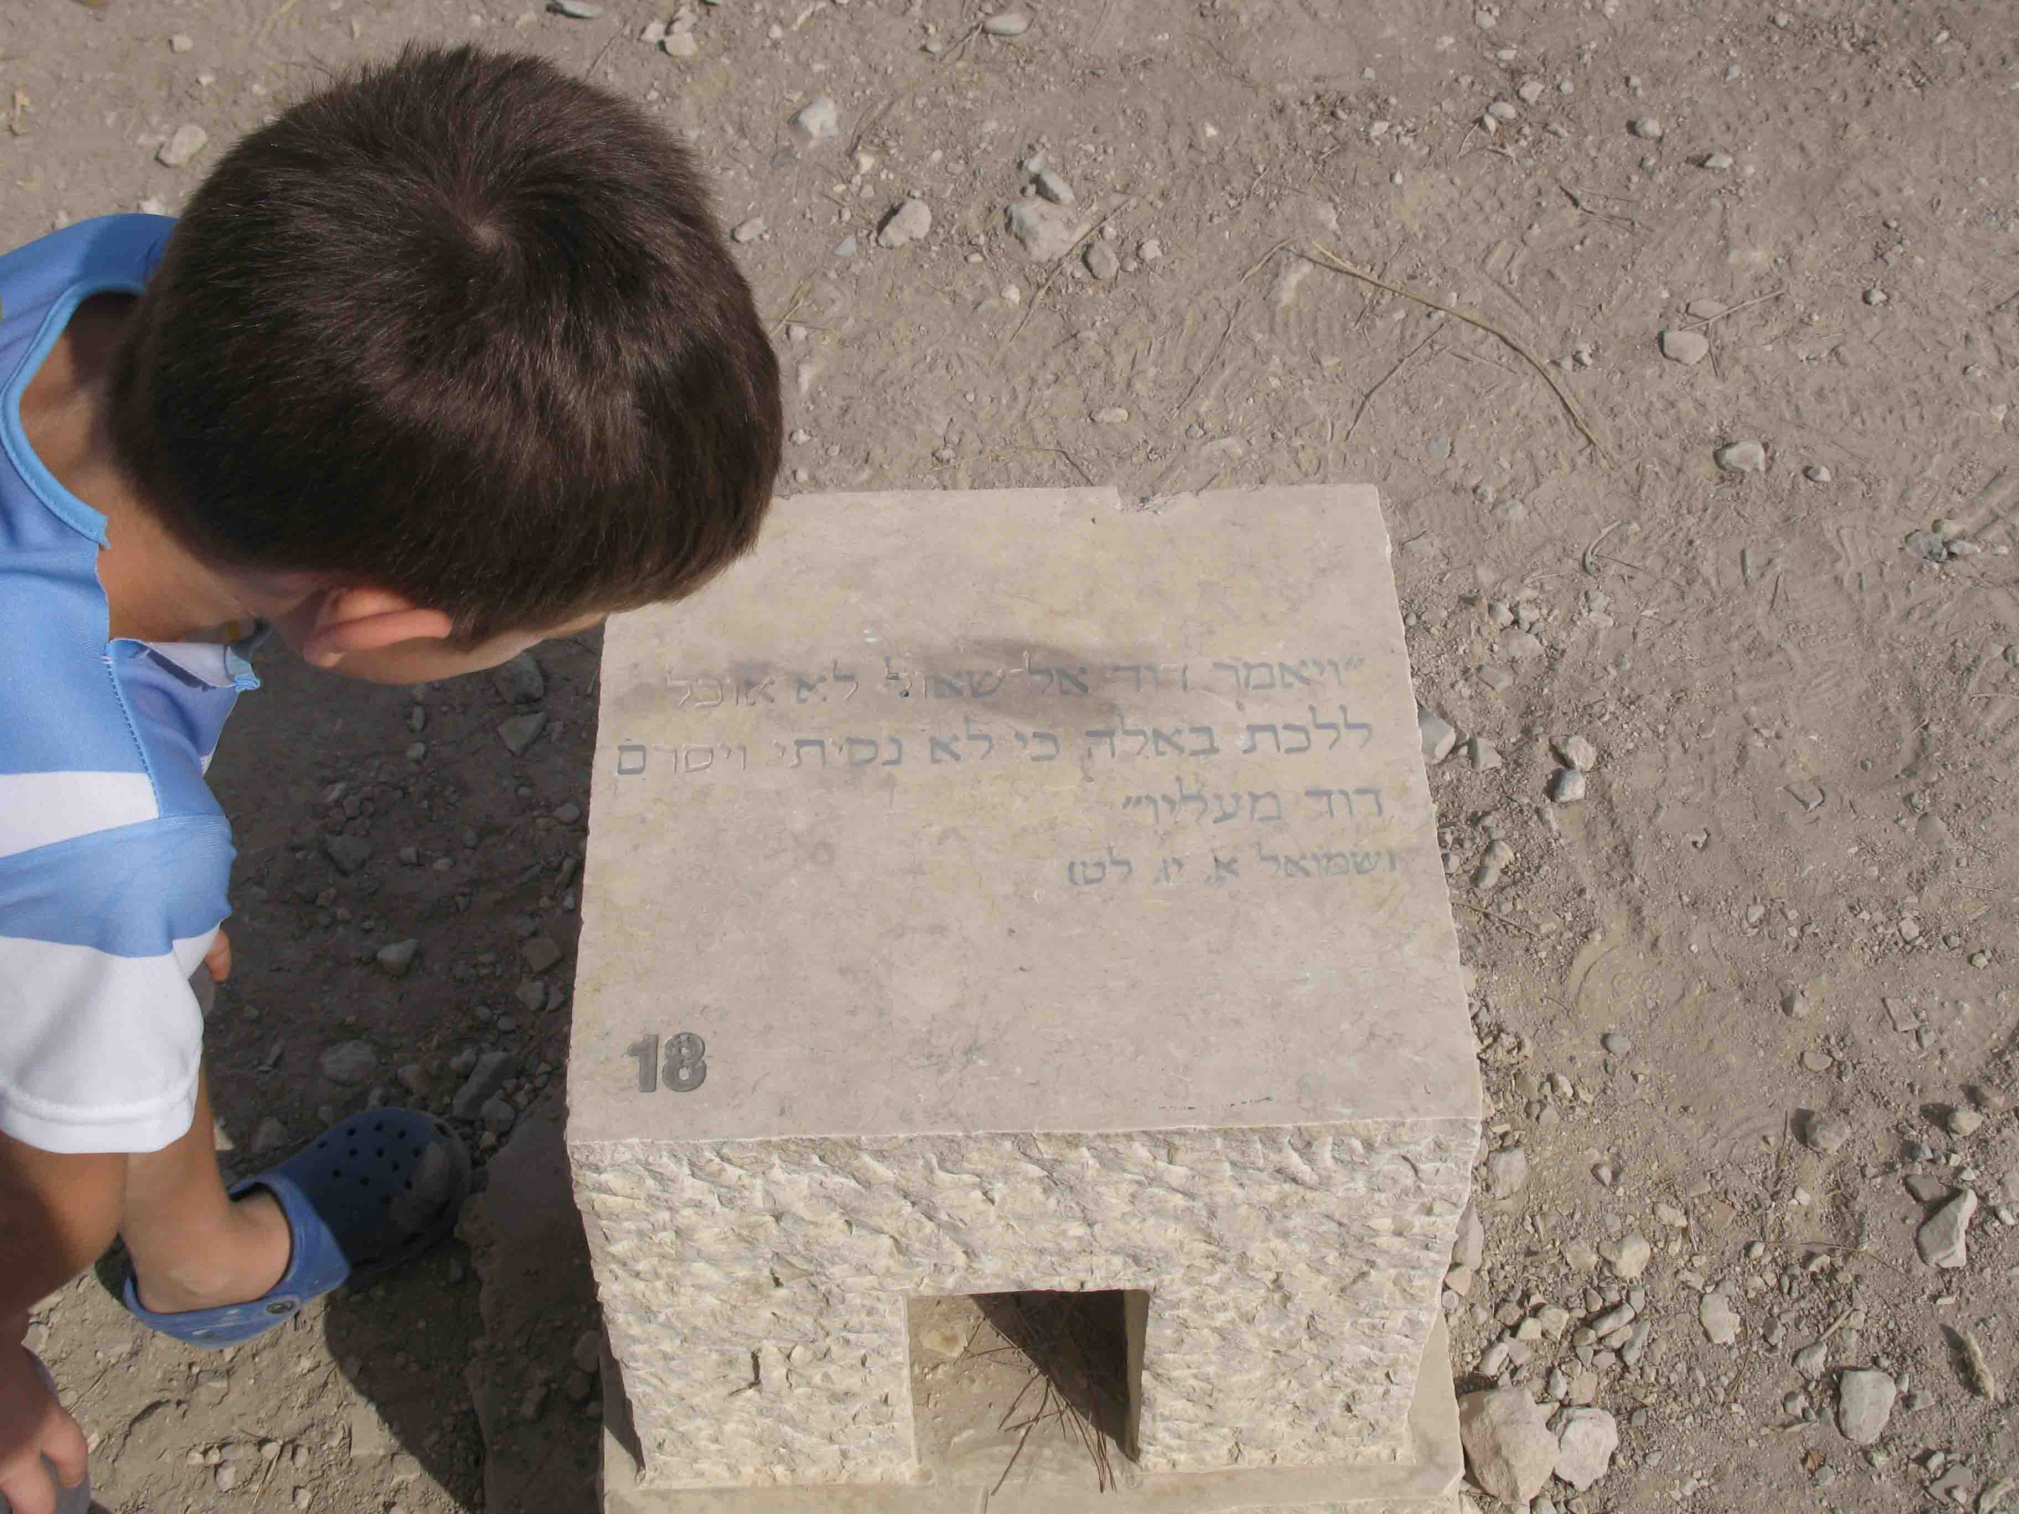

Slide 20
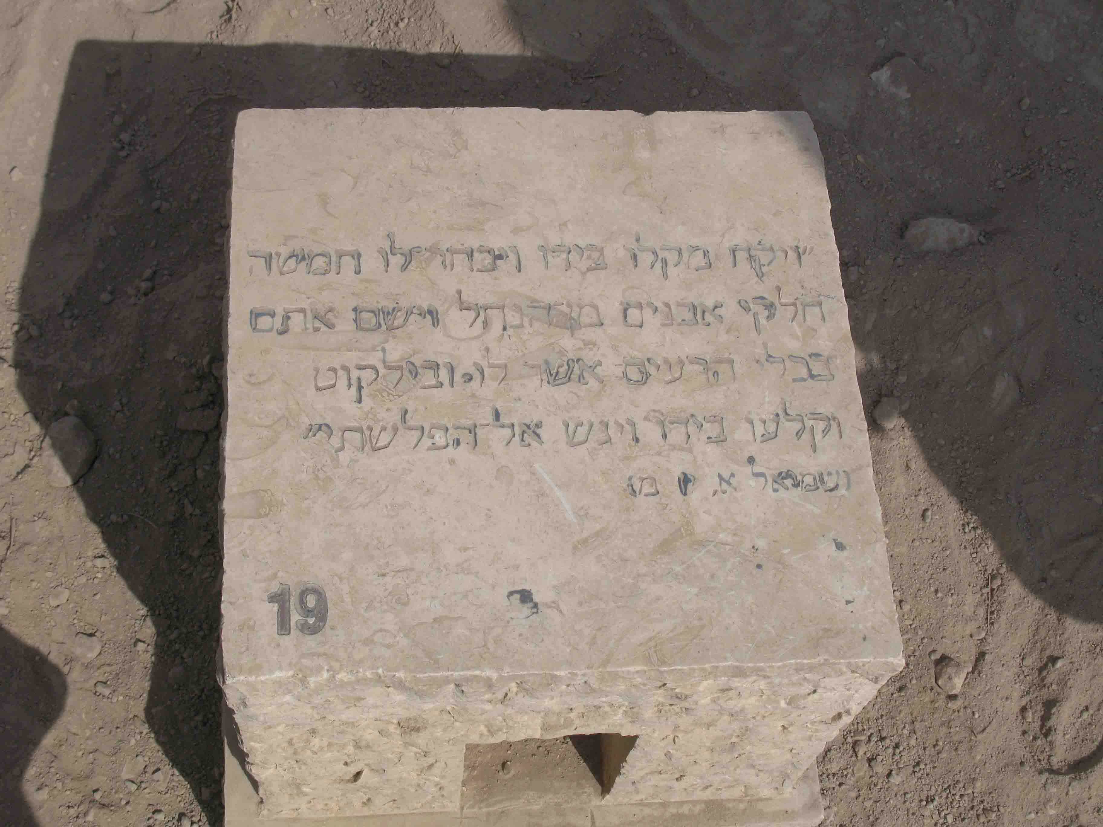

Slide 21
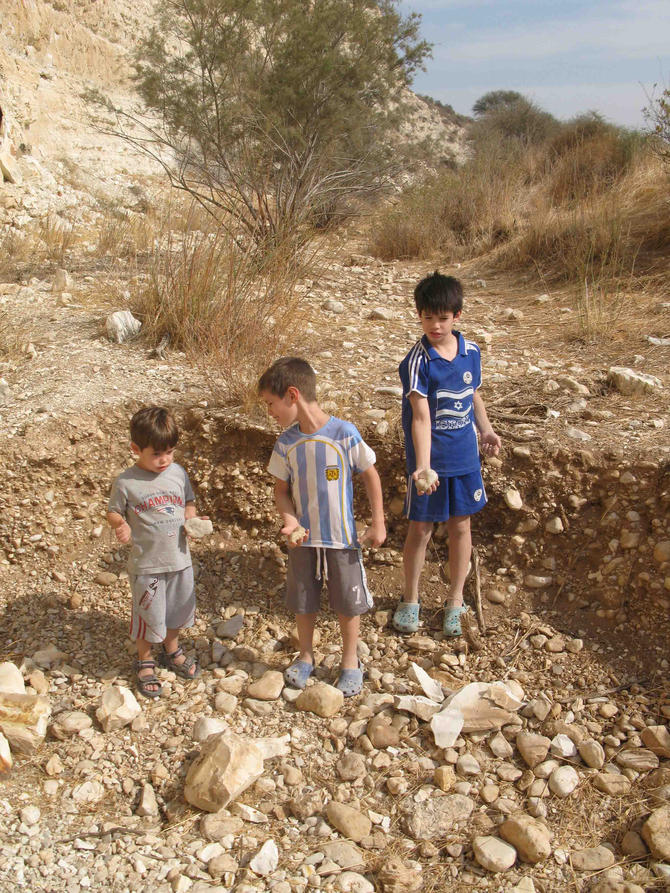

Slide 22
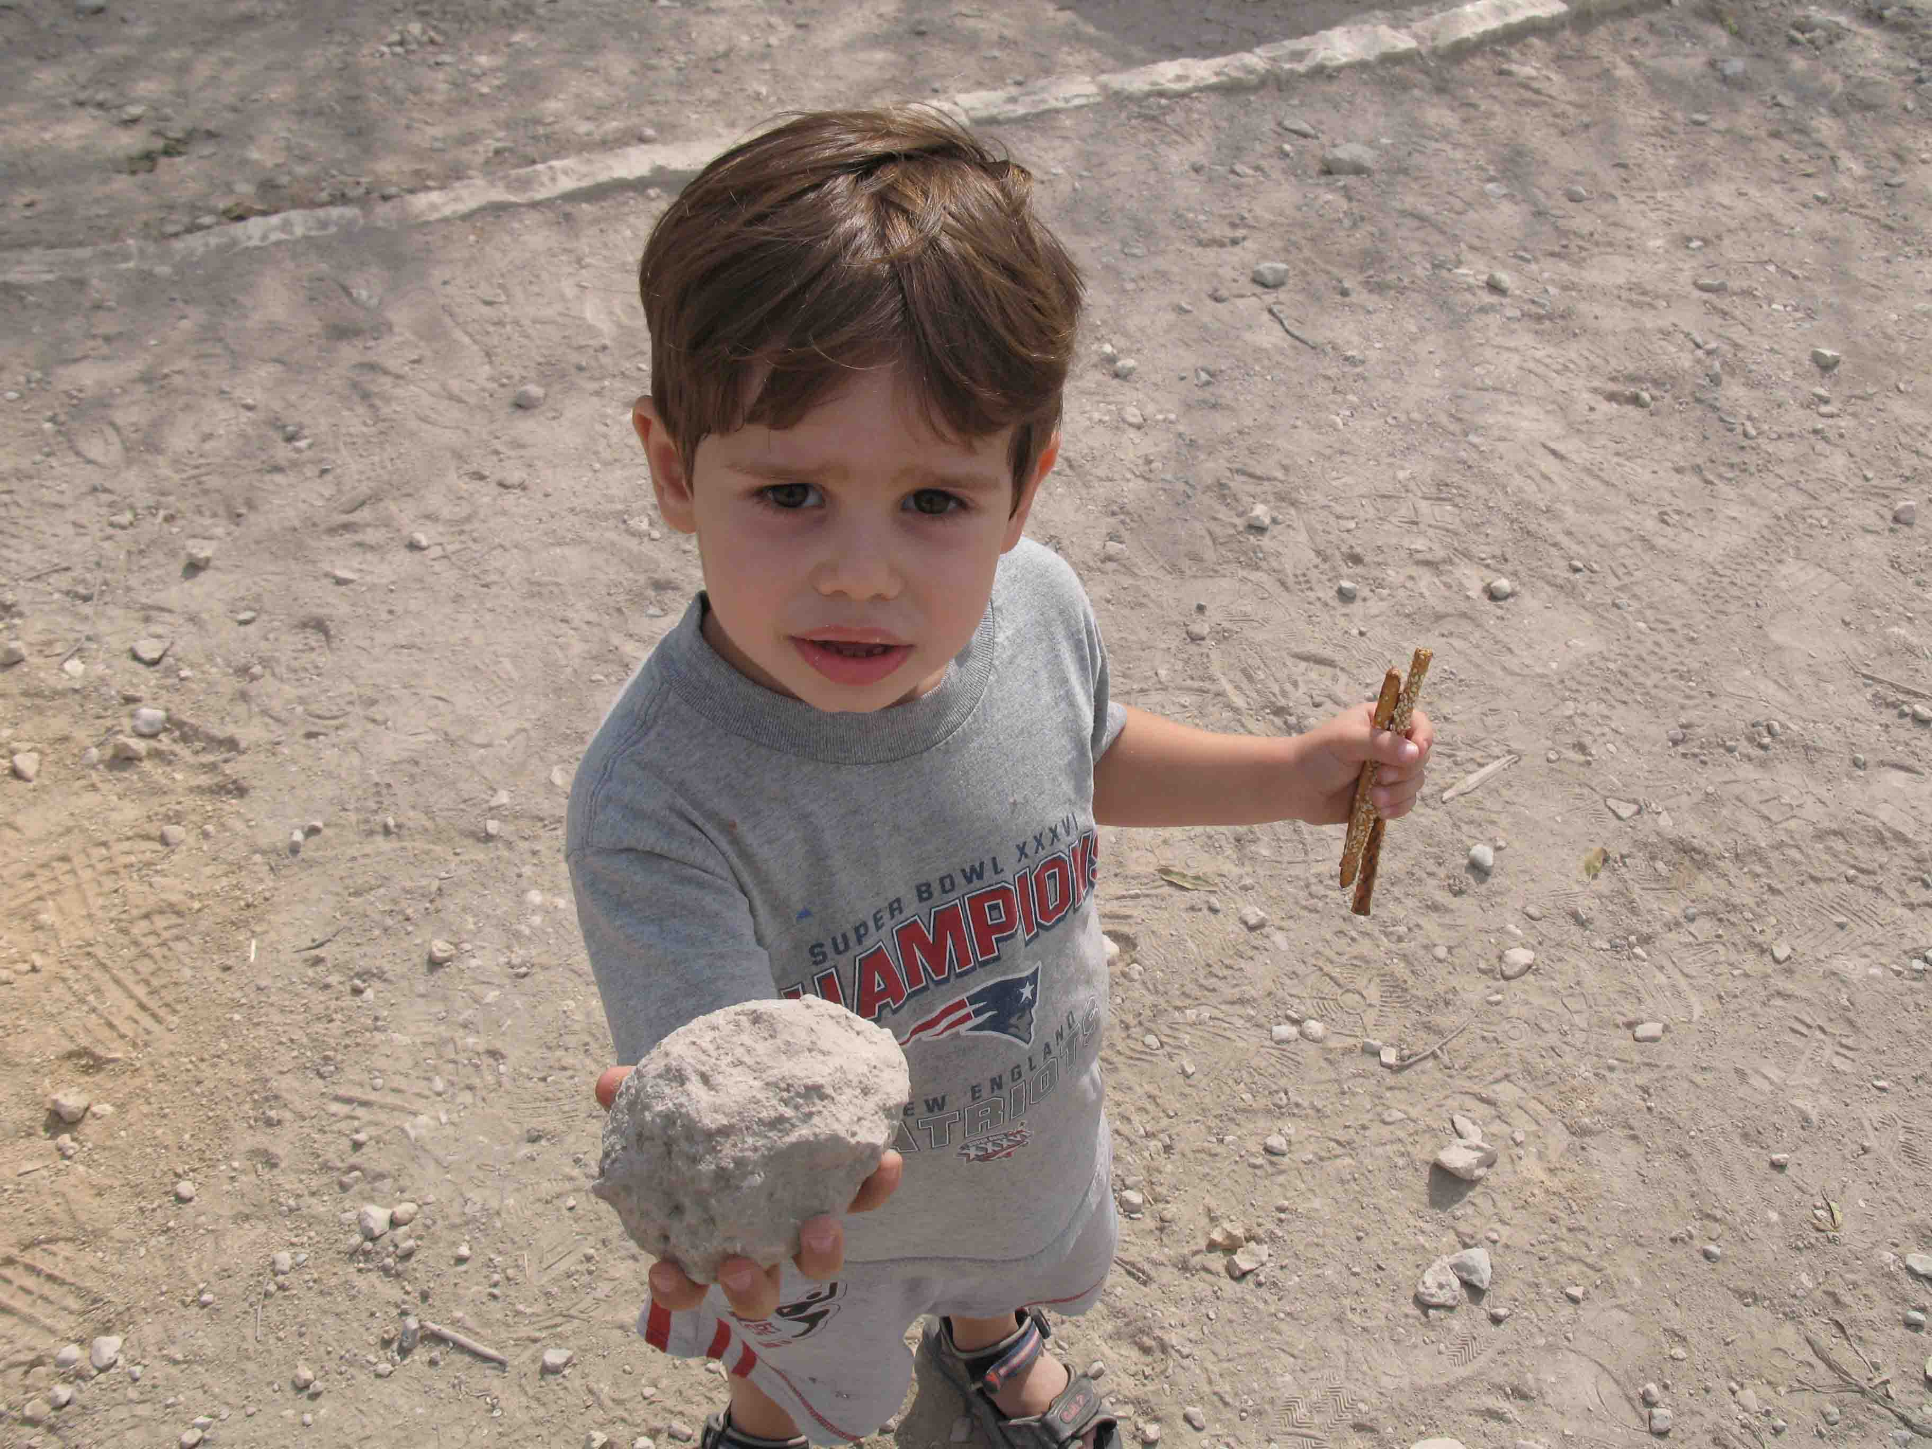

Slide 23
מא וַיֵּלֶךְ, הַפְּלִשְׁתִּי, הֹלֵךְ וְקָרֵב, אֶל-דָּוִד; וְהָאִישׁ נֹשֵׂא הַצִּנָּה, לְפָנָיו. | 41 And the Philistine came nearer and nearer unto David; and the man that bore the shield went before him.
מב וַיַּבֵּט הַפְּלִשְׁתִּי וַיִּרְאֶה אֶת-דָּוִד, וַיִּבְזֵהוּ: כִּי-הָיָה נַעַר, וְאַדְמֹנִי עִם-יְפֵה מַרְאֶה. | 42 And when the Philistine looked about, and saw David, he disdained him; for he was but a youth, and ruddy, and withal of a fair countenance.
מג וַיֹּאמֶר הַפְּלִשְׁתִּי, אֶל-דָּוִד, הֲכֶלֶב אָנֹכִי, כִּי-אַתָּה בָא-אֵלַי בַּמַּקְלוֹת; וַיְקַלֵּל הַפְּלִשְׁתִּי אֶת-דָּוִד, בֵּאלֹהָיו. | 43 And the Philistine said unto David: 'Am I a dog, that thou comest to me with staves?' And the Philistine cursed David by his god.

Slide 24
מד וַיֹּאמֶר הַפְּלִשְׁתִּי, אֶל-דָּוִד: לְכָה אֵלַי--וְאֶתְּנָה אֶת-בְּשָׂרְךָ, לְעוֹף הַשָּׁמַיִם וּלְבֶהֱמַת הַשָּׂדֶה. {ס} | 44 And the Philistine said to David: 'Come to me, and I will give thy flesh unto the fowls of the air, and to the beasts of the field.' {S}
מה וַיֹּאמֶר דָּוִד, אֶל-הַפְּלִשְׁתִּי, אַתָּה בָּא אֵלַי, בְּחֶרֶב וּבַחֲנִית וּבְכִידוֹן; וְאָנֹכִי בָא-אֵלֶיךָ, בְּשֵׁם יְהוָה צְבָאוֹת, אֱלֹהֵי מַעַרְכוֹת יִשְׂרָאֵל, אֲשֶׁר חֵרַפְתָּ. | 45 Then said David to the Philistine: 'Thou comest to me with a sword, and with a spear, and with a javelin; but I come to thee in the name of the LORD of hosts, the God of the armies of Israel, whom thou hast taunted.
מז וְיֵדְעוּ כָּל-הַקָּהָל הַזֶּה, כִּי-לֹא בְּחֶרֶב וּבַחֲנִית יְהוֹשִׁיעַ יְהוָה: כִּי לַיהוָה הַמִּלְחָמָה, וְנָתַן אֶתְכֶם בְּיָדֵנוּ. {ס} | 47 and that all this assembly may know that the LORD saveth not with sword and spear; for the battle is the LORD'S, and He will give you into our hand.' {S}

Slide 25
מח וְהָיָה כִּי-קָם הַפְּלִשְׁתִּי, וַיֵּלֶךְ וַיִּקְרַב לִקְרַאת דָּוִד; וַיְמַהֵר דָּוִד, וַיָּרָץ הַמַּעֲרָכָה לִקְרַאת הַפְּלִשְׁתִּי. | 48 And it came to pass, when the Philistine arose, and came and drew nigh to meet David, that David hastened, and ran toward the army to meet the Philistine.
מט וַיִּשְׁלַח דָּוִד אֶת-יָדוֹ אֶל-הַכֶּלִי, וַיִּקַּח מִשָּׁם אֶבֶן וַיְקַלַּע, וַיַּךְ אֶת-הַפְּלִשְׁתִּי, אֶל-מִצְחוֹ; וַתִּטְבַּע הָאֶבֶן בְּמִצְחוֹ, וַיִּפֹּל עַל-פָּנָיו אָרְצָה. | 49 And David put his hand in his bag, and took thence a stone, and slung it, and smote the Philistine in his forehead; and the stone sank into his forehead, and he fell upon his face to the earth.

Slide 26
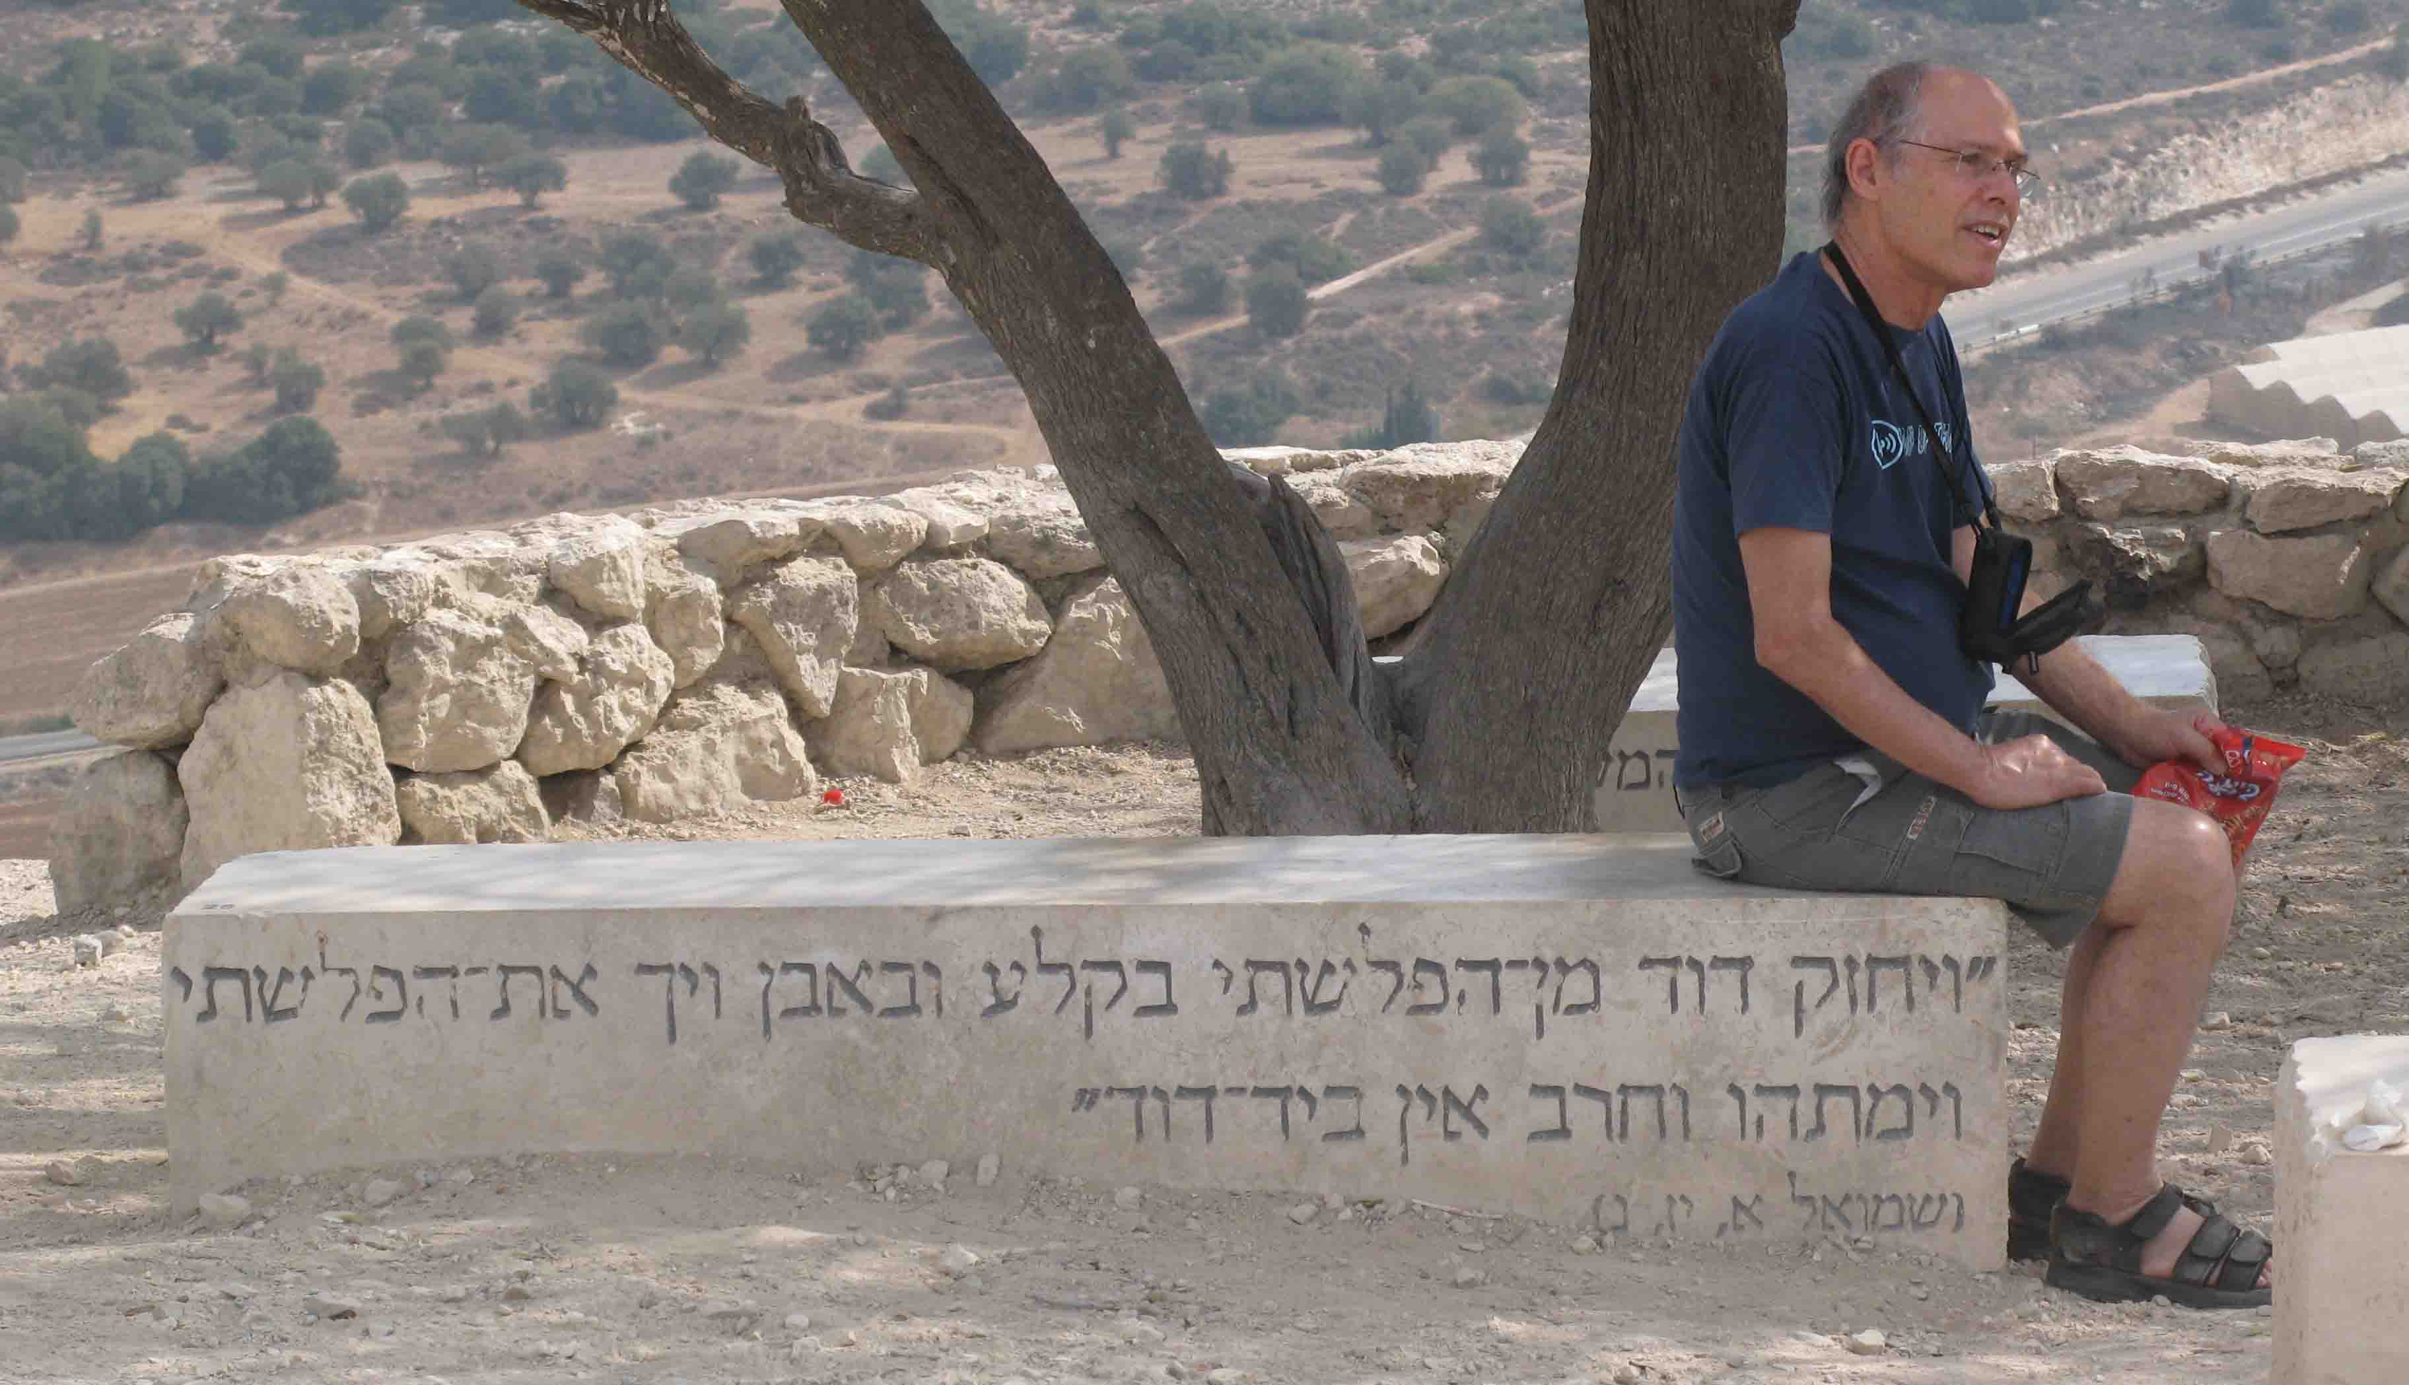
http://www.youtube.com/watch?v=hXIWh7c5css

Slide 27
נא וַיָּרָץ דָּוִד וַיַּעֲמֹד אֶל-הַפְּלִשְׁתִּי וַיִּקַּח אֶת-חַרְבּוֹ וַיִּשְׁלְפָהּ מִתַּעְרָהּ, וַיְמֹתְתֵהוּ, וַיִּכְרָת-בָּהּ, אֶת-רֹאשׁוֹ; וַיִּרְאוּ הַפְּלִשְׁתִּים כִּי-מֵת גִּבּוֹרָם, וַיָּנֻסוּ. | 51 And David ran, and stood over the Philistine, and took his sword, and drew it out of the sheath thereof, and slew him, and cut off his head therewith. And when the Philistines saw that their mighty man was dead, they fled.
נב וַיָּקֻמוּ אַנְשֵׁי יִשְׂרָאֵל וִיהוּדָה וַיָּרִעוּ, וַיִּרְדְּפוּ אֶת-הַפְּלִשְׁתִּים, עַד-בּוֹאֲךָ גַיְא, וְעַד שַׁעֲרֵי עֶקְרוֹן; וַיִּפְּלוּ חַלְלֵי פְלִשְׁתִּים, בְּדֶרֶךְ שַׁעֲרַיִם, וְעַד-גַּת, וְעַד-עֶקְרוֹן. | 52 And the men of Israel and of Judah arose, and shouted, and pursued the Philistines, until thou comest to Gai, and to the gates of Ekron. And the wounded of the Philistines fell down by the way to Shaaraim, even unto Gath, and unto Ekron.

Slide 28
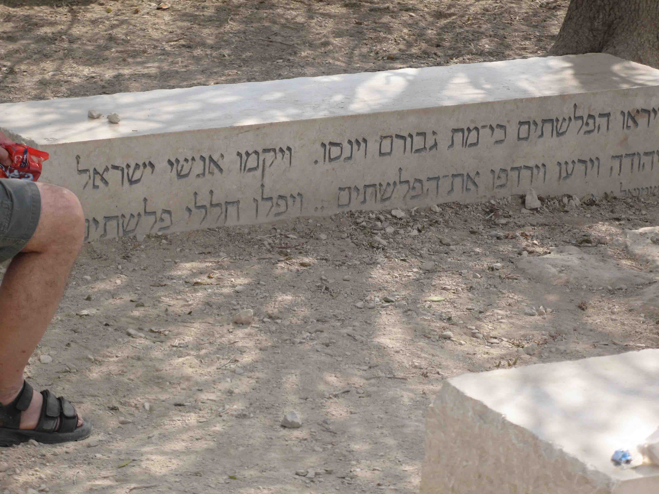

Slide 29
http://www.mapa.co.il/general/searchresult_locked.asp
http://www.mapa.co.il/general/searchresult_locked.asp?textsearch=%e8%e9%e5%ec%e9%ed&first=1&minx=109354.84375&miny=1112964.421875&maxx=166425.15625&maxy=1141499.578125&mapearthx=137890&mapearthy=1127232&mapzoom=15000&currheadertab=1&geosearchradius=50000&centerx=&centery=&geopoiname=&sourcex=&sourcey=&sourcepoint=&sourceaddinfo=&rsf_viewstate=&filter=&filterpath=&subjectid=&textsearchwhere=%f6%e5%ee%fa+%f2%e6%f7%e4&resultstargetonmap=on&UserEarthX=126374&UserEarthY=1135740&UserMapZoom=15000&LoadUserPosition=1&MapType=combination&ImagesOption=COMB_&CurrMapTab=6&LoadPOIFromSession=&PNGLayers=

Slide 31
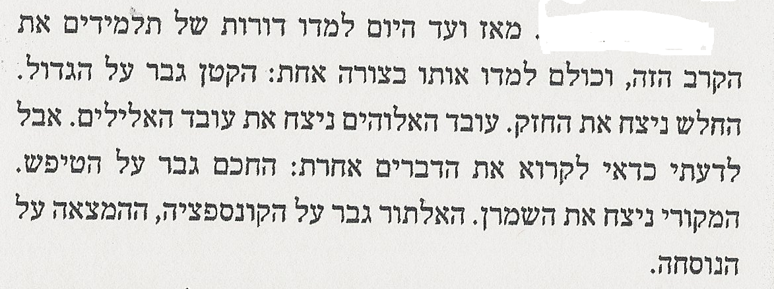
גבר, לגבור to overcome
עובד אלוהים devoted to God
עובד אלילים idolater
שמרן conservative
אלתור improvisation
המצאה invention
נוסחה formula, convention

