Slide 1
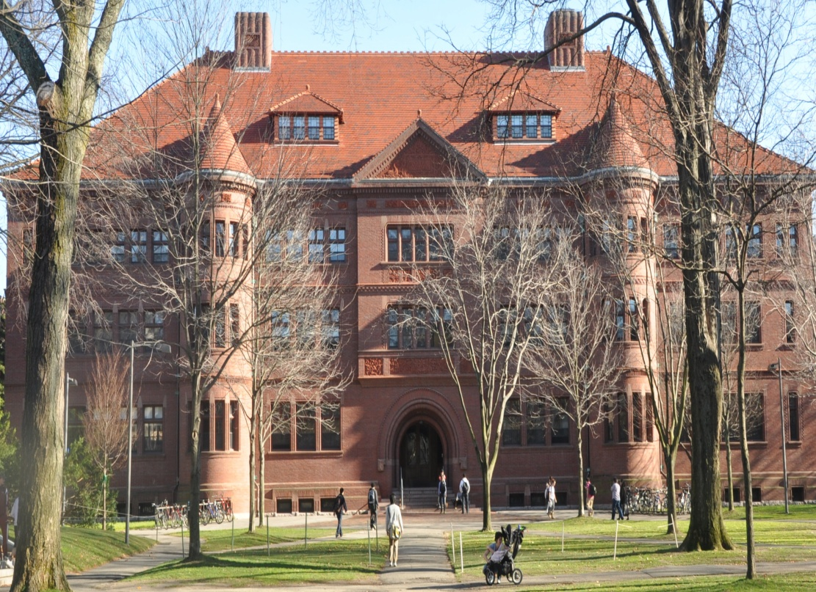
MODERN HEBREW AT HARVARD
WHY?
WHAT?
HOW?

Slide 2
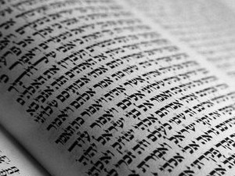
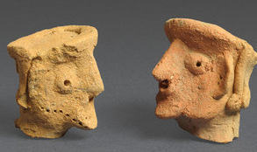
WHY?
Ancient – Modern living language
Language of academic research:
Bible studies
Jewish studies
Archeology
Linguistics
Middle Eastern studies
(political science)
History

Slide 3
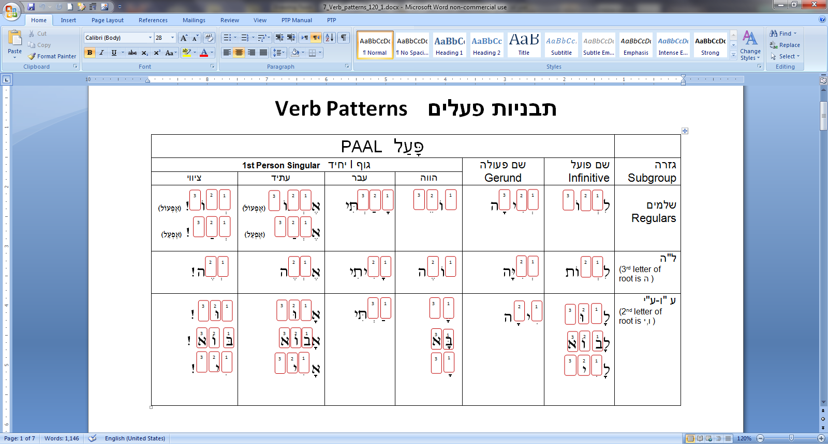
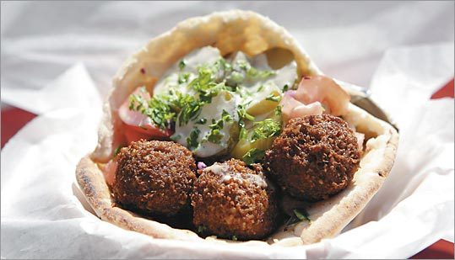
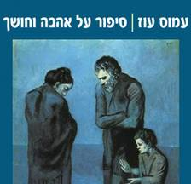
WHAT?
4 proficiencies:
reading, writing, speaking, listening
4 levels:
Beginners, intermediate,
advanced intermediate,
highly advanced
4 fields:
grammar, morphology, textual diversity, culture

Slide 4
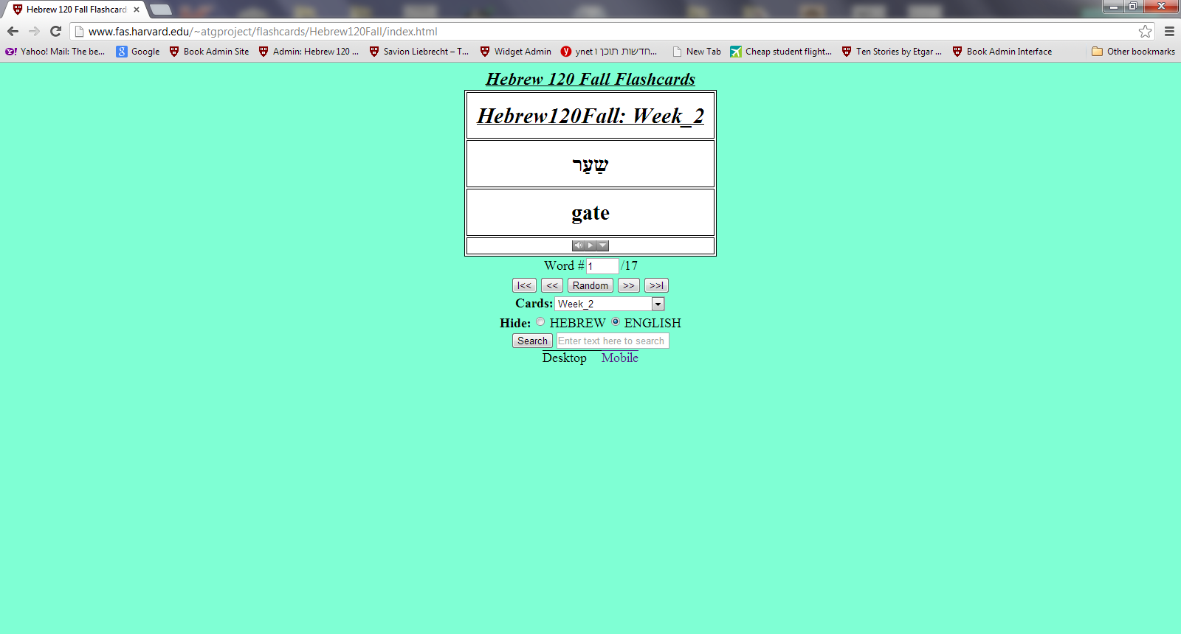

HOW?
Media
Songs
Conversation sections
Variety of games and exercises for all types of learners
Digital tools – flash cards, books on tape
Guest speakers
Movies

Slide 5
What our students say about us:
“This course is fun, and you learn a LOT of Hebrew. Indeed, I've studied many languages, and I had never learned so much language in just one year of instruction. It is very rewarding.“

