Slide 1
A Very Short History of the Modern Hebrew Language
Irit Aharony

Slide 2
Semitic languages
languages that form a branch of the Afro-Asiatic languages. Members of the Semitic group are spread throughout North Africa, Southwest Asia, and the Middle East for more than 4,000 years.
These languages branched from a
Proto Semitic Language

Slide 3
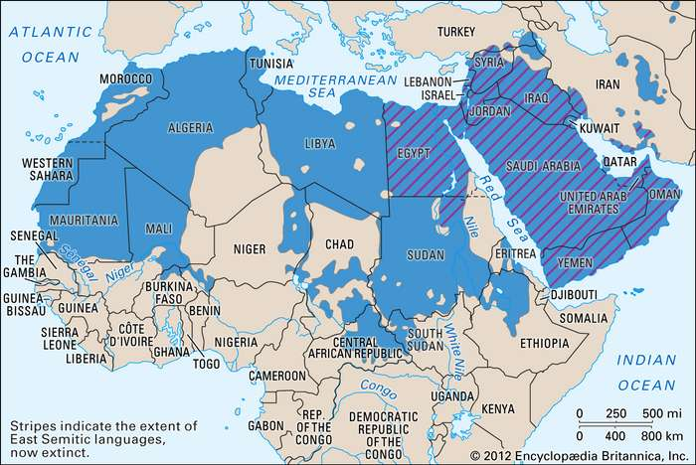
Distribution of Semitic Languages (Britannica)

Slide 4
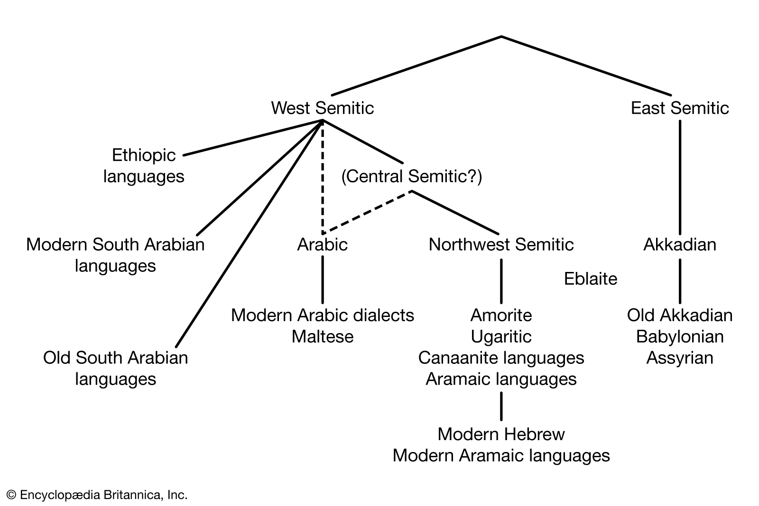
Branches of Semitic Languages (Britannica)

Slide 5
Phases of the Hebrew Language
Biblical Hebrew (ca. 12th – 2nd century BCE)
Archaic Biblical Hebrew (12th – 11th century BCE)
Standard Biblical Hebrew (10th – 6th century BCE)
Late Biblical Hebrew (6th – 2nd century BCE)

Slide 6
Rabbinic or Mishnaic Hebrew (2ND BCE – 5TH CE)
Medieval Hebrew (6th – 18th )
Modern Hebrew
Early Modern (18th – late 19th)
Israeli (1881 – present)

Slide 7
Contemporary Hebrew (Israelit)
Hebrew today contains words from all periods of the language, foreign words from other ancient languages,
and words from modern languages:
Arabic
Yiddish
Ladino
Russian
French
English
And more….

Slide 8
צריך להדפיס את העיתון
It is needed to print the newspaper
"צריך"
Rabbinical Hebrew
"להדפיס"
Medieval Hebrew
"את"
Biblical Hebrew
"עיתון"
Modern Hebrew

Slide 9
IDF Language
Acronyms
רמטכ''ל
Compound words שיפצור
Suffix in masculine plural נשקים
Suffix 'יסט
שוקיסט
Suffix from Russian 'ציק
גולנצי'ק
Suffix from Russian 'יק
גו'בניק
Words from Arabic
מוהנדס

Slide 10
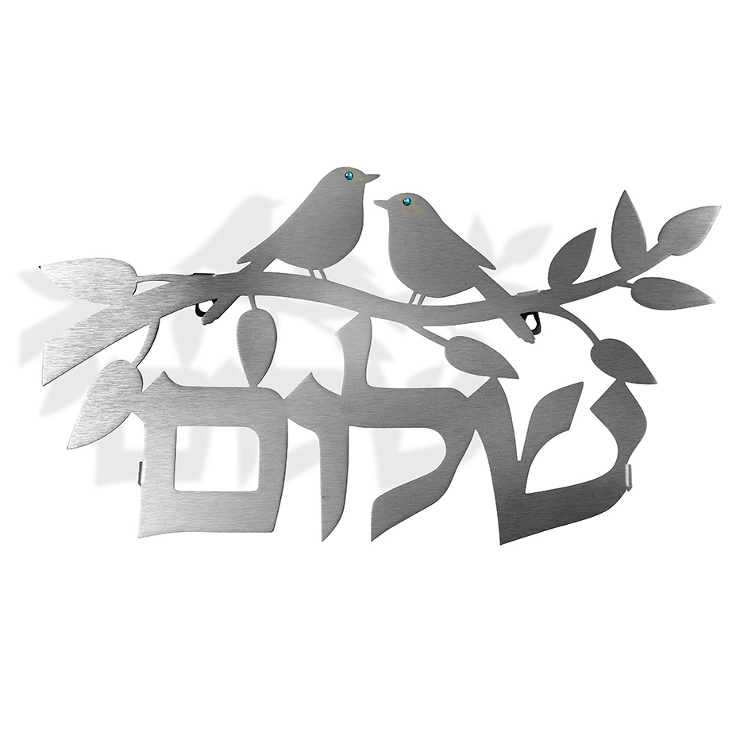

יאללה, ביי, שלום
Yallah, bye, shalom

